Slide 1

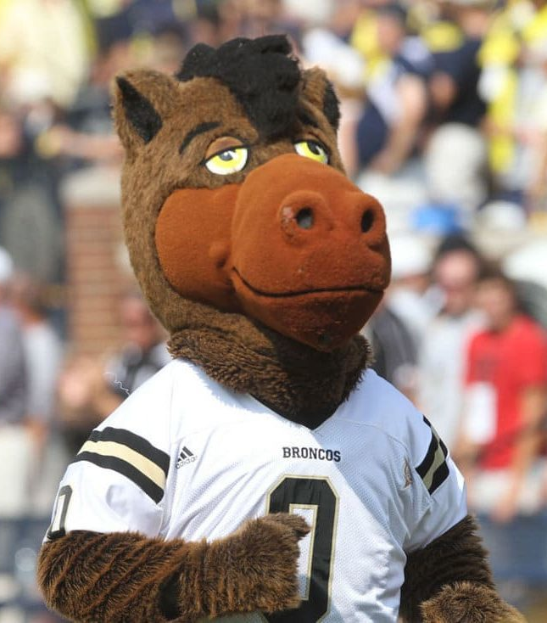

Buster Bronco
Fall 2025 Graduate
Bachelor of Science in
Engineering Manufacturing Engineering Technology

