Slide 1

Academic Advising at WMU
Orientation2026

Slide 2
Academic Advising at Western Michigan University
Orientation 2026
Presented by: Tomika D. Griffin-Brown
Assistant Dean of Academic Advising
wmich.edu/advising/contact

Slide 3
Using the Student Success Hub
Orientation 2026

Slide 4
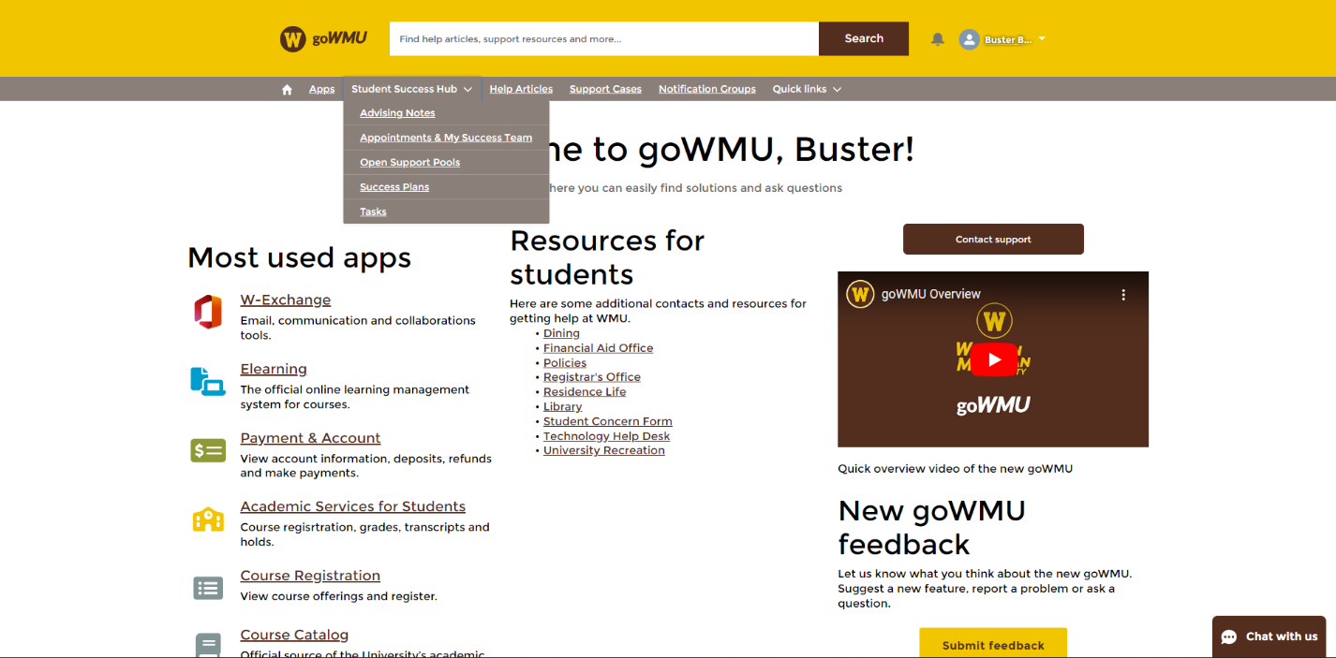
Where can I find the Student Success Hub?
Log in to goWMU with your Bronco NetID and password
Select “Student Success Hub” from the dropdown

Slide 5
Menu Drop-down Options
Advising Notes
  View notes from advisors from previous meetings
Appointment and My Success Team
  Home page; view team members, appointments or schedule appointments
Open Support Pools
  Schedule an appointment with support staff that are not on your team
Success Plans
  View success plans assigned to you by support staff
Tasks
  View individual tasks or tasks from support plans
  assigned to you

Slide 6
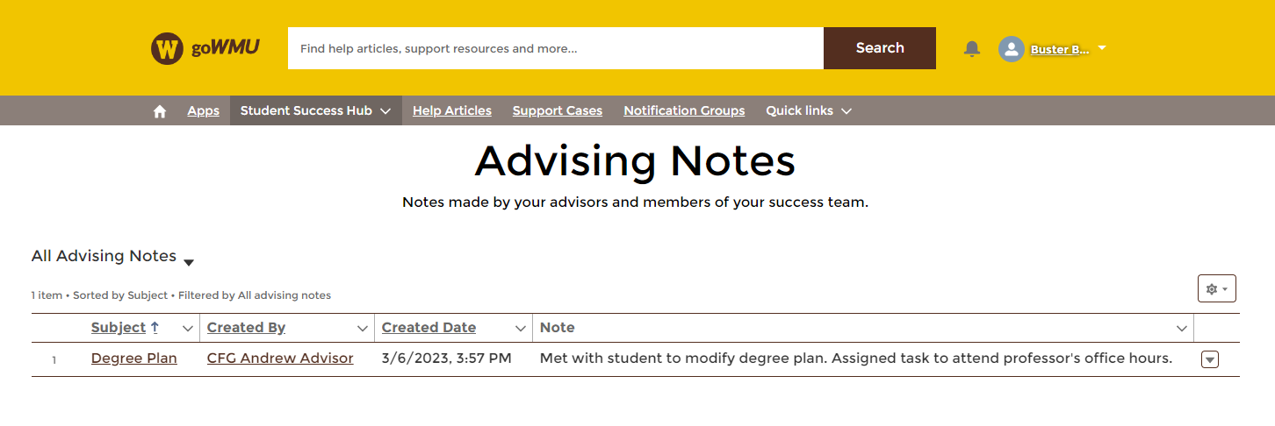
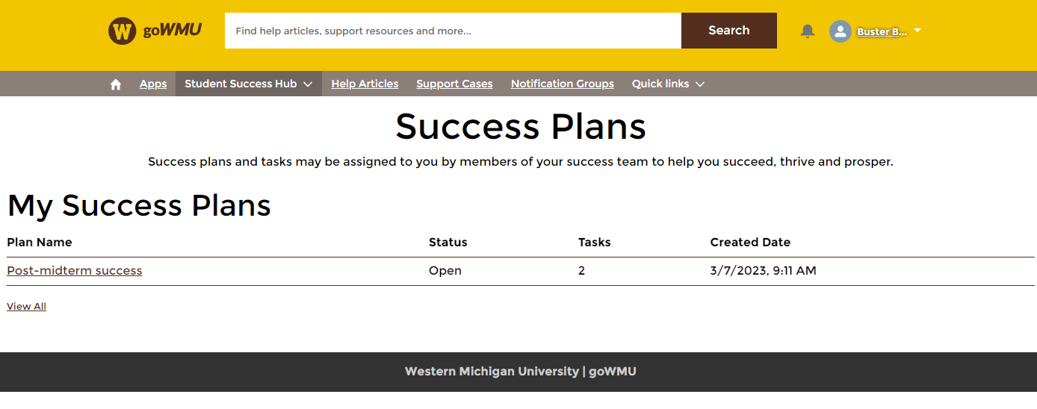
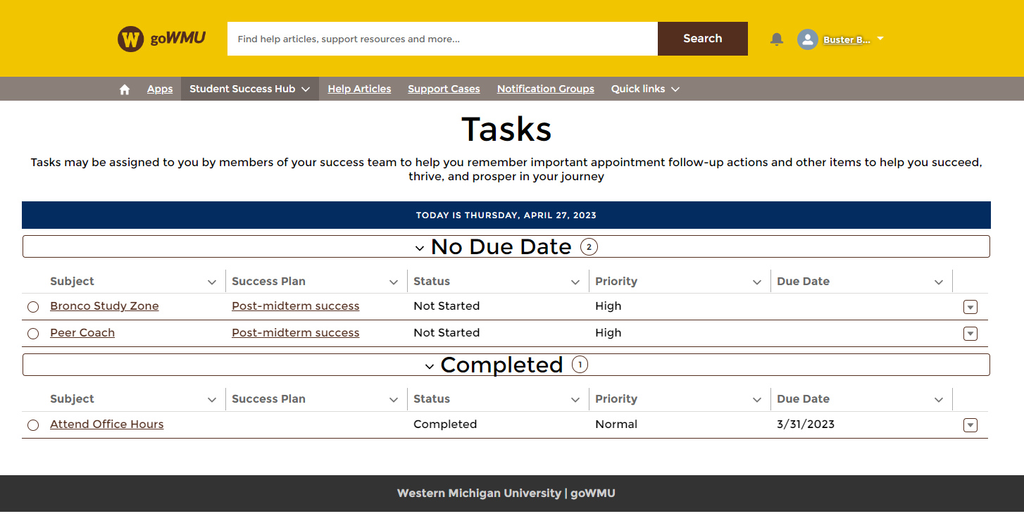
Advising Notes
  View notes from advisors from previous meetings
Success Plans
  View success plans assigned to you by support staff
Tasks
  View individual tasks or tasks from support plans assigned to you
  Update progress or status of tasks as you complete them

Slide 7
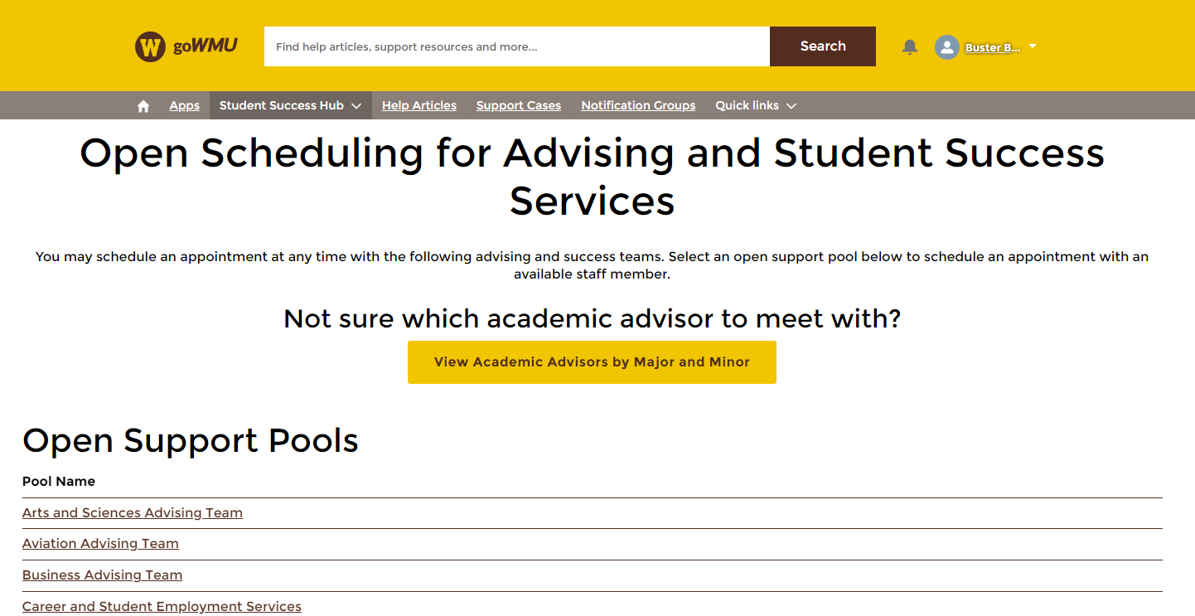
Open Scheduling

Slide 8
Open Support Pools
Schedule an appointment with support staff that are not on your assigned team
Meet with academic advisors for other majors and colleges
Schedule appointments with other student services, including:
  Career and Student Employment Services
  Lee Honors College
  Navigation Specialists
  Signature Project

Slide 9
Meeting with Academic Advisors
Before scheduling an appointment, use the “View Academic Advisors by Major and Minor” to confirm who you should meet with
Identify the designated advisor for the major or minor you are interested in, then schedule with them

Slide 10
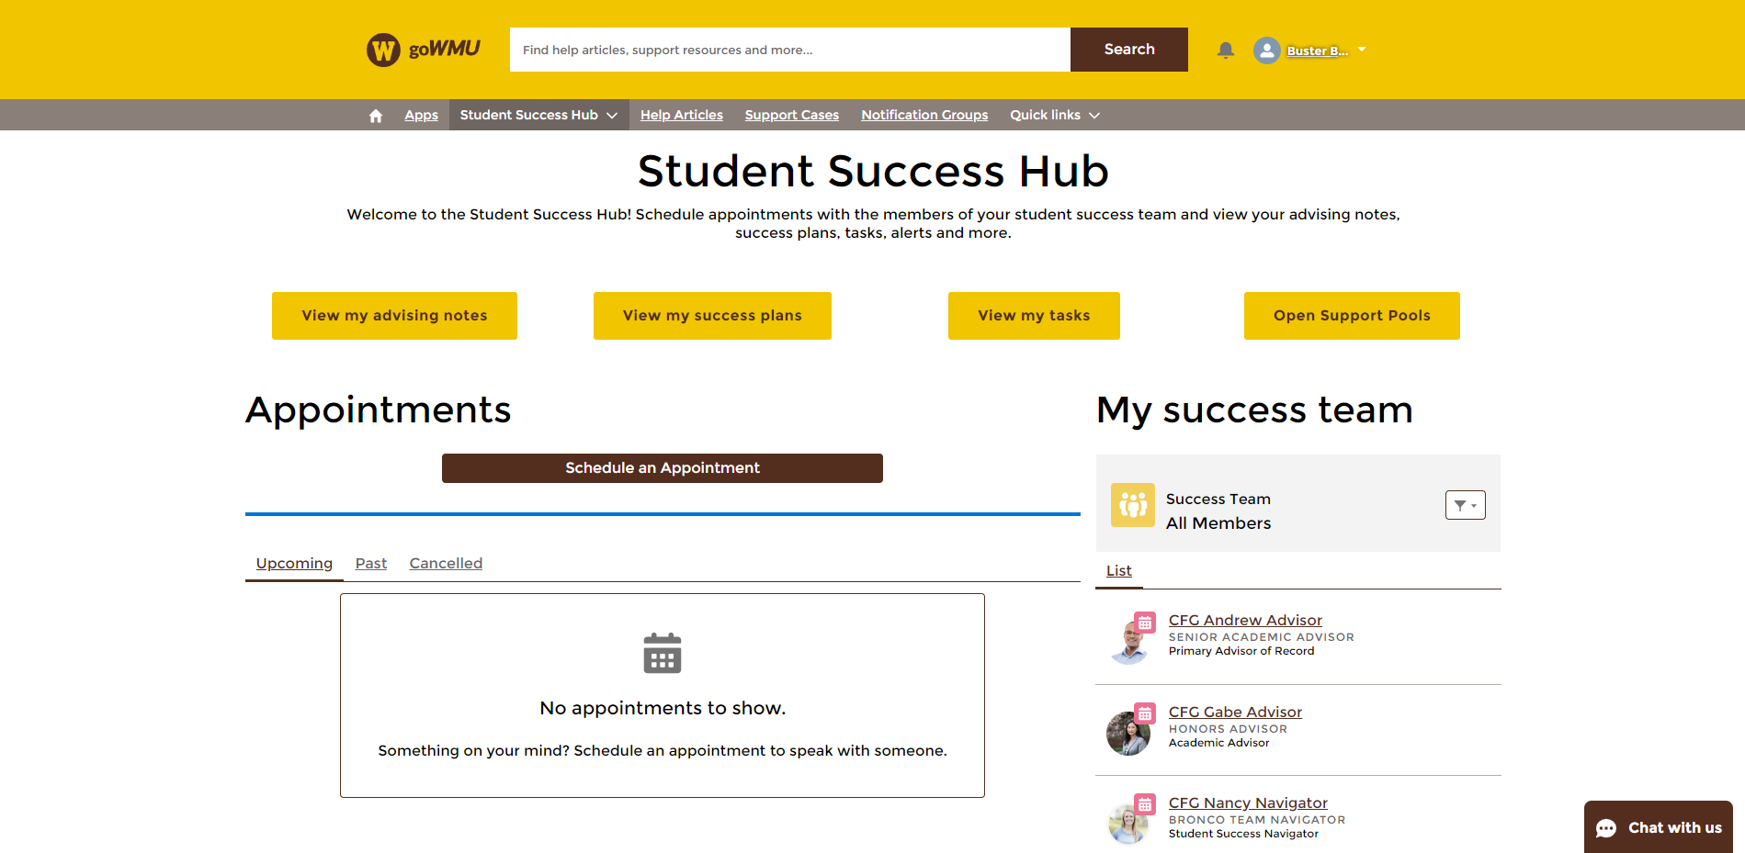
SSH Home Page

Slide 11
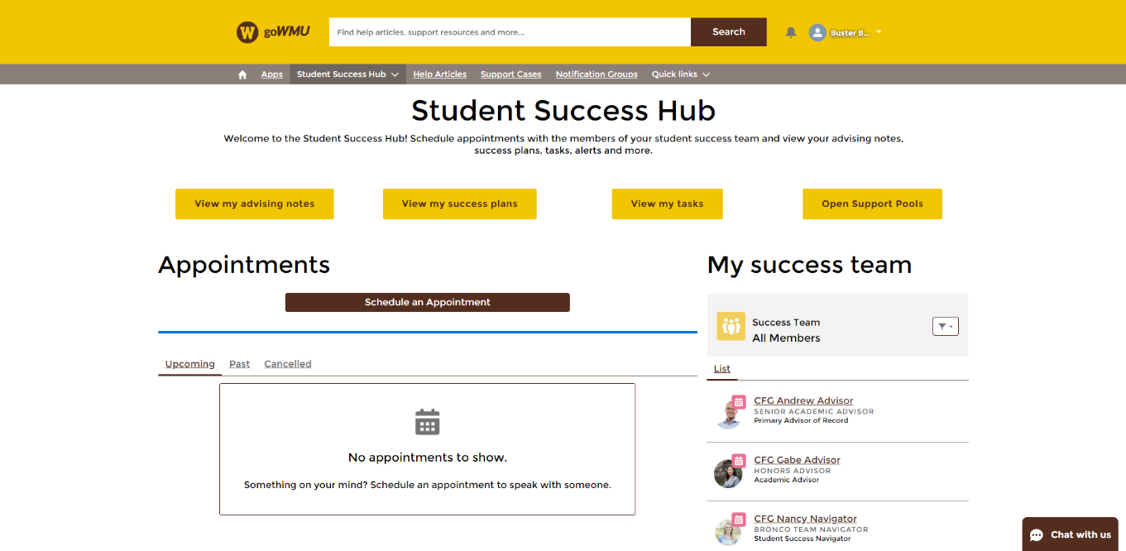
Home Page
Accessed from the SSH dropdown menu, then selecting “Appointments & My Success Team”
View upcoming, past, and canceled appointments
Schedule new appointments
View members of your success team and their info
Access advising notes, success plans, tasks, and open support pools
Provide feedback for the Student Success Hub

Slide 12
How to Schedule Appointment
1. Navigate to SSH and click on Appointments & My Success Team
2. Click “Schedule an Appointment”
3. Click “Assigned” to view your success team
  You can also search for any support staff assigned to you
4. Select the support staff member you would like to meet with
5. Select a topic and a subtopic for the meeting you are scheduling
6. Select a date and time for your meeting
  Make note of the type of meeting: Drop-In, Scheduled, Group
7. Confirm the meeting information on the “Confirm Appointment” page
8. If there are multiple locations offered, select the desired option from the list to finish scheduling your appointment

Slide 13
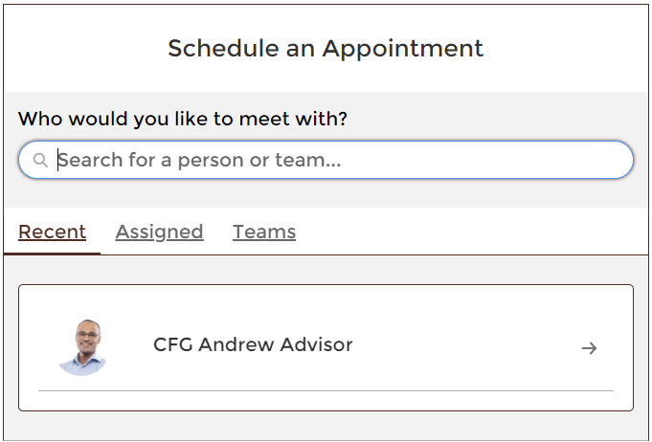
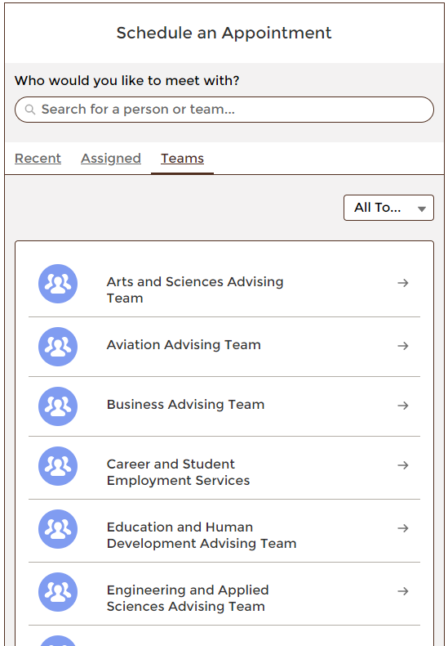
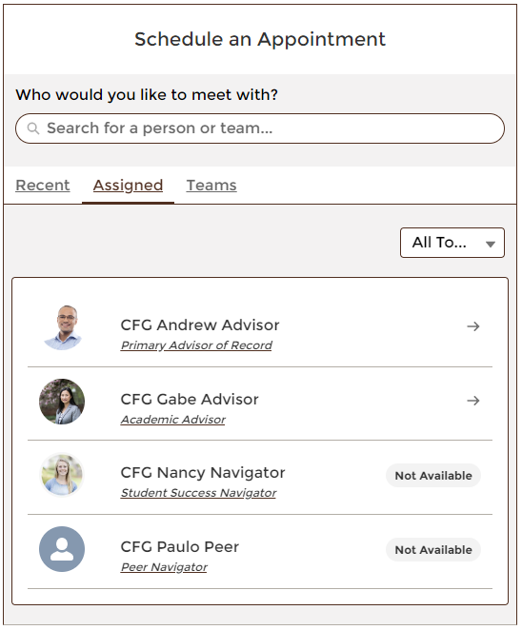
Selecting Support Staff
Recent
Anyone you have met with recently
This may not have any options
Teams
Open scheduling with advisor pools
Meet with advisors from other departments
Check for the college’s designated advisor(s) for the major/minor you are interested in before scheduling an appoinment
Assigned
Any support staff assigned directly to you
You will find your peer navigators and advisors here

Slide 14
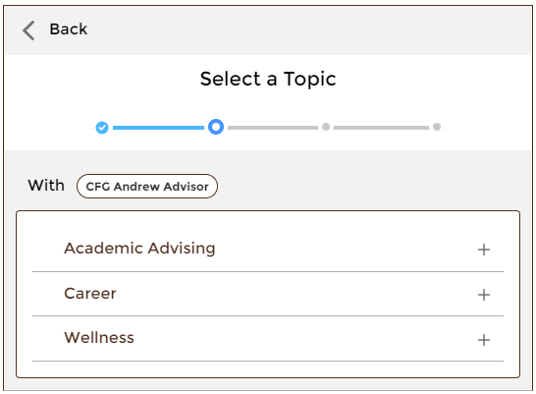
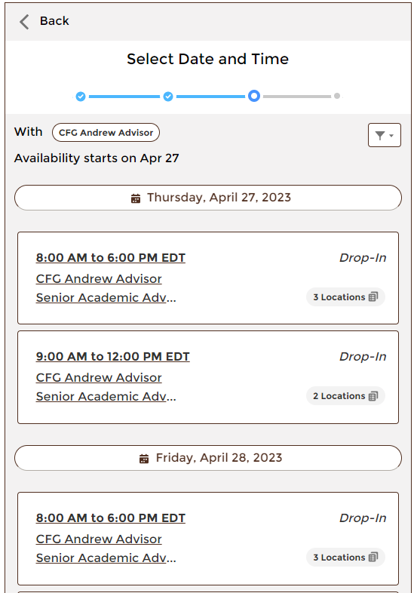
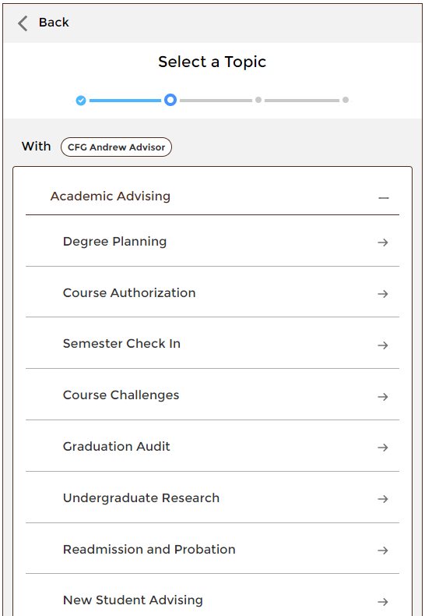
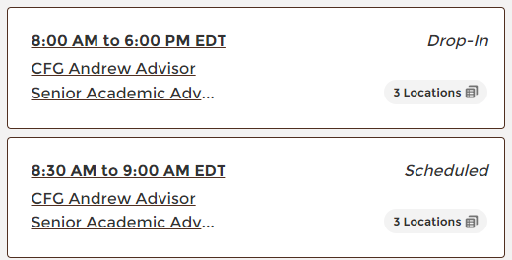
Selecting an Appointment
Select a Topic
The main reason for the appointment
Select Date and Time
Select a time for the appointment
Choices are separated by dates
Keep note of the appointment types
Appointment Types
Drop-in – Cannot be scheduled; first-come, first-serve
Scheduled – One-on-one appointment on a specific day/time
Group – Multiple students will attend the same appointment
Select a Subtopic
View available subtopics by selecting a topic
Select specific meeting topic based on your needs

Slide 15
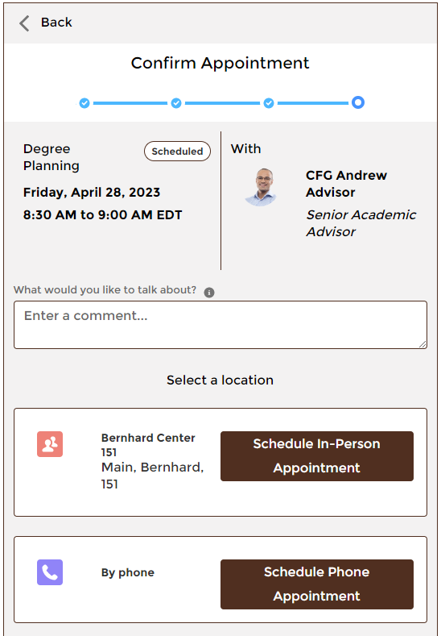
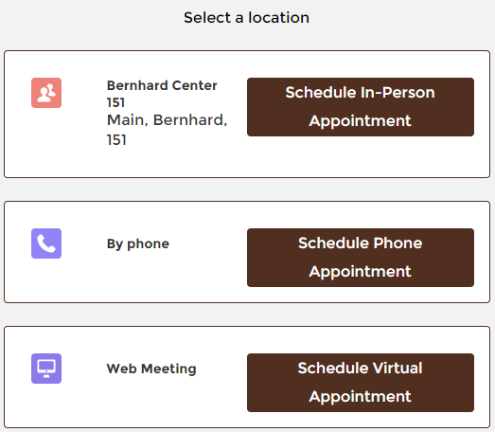
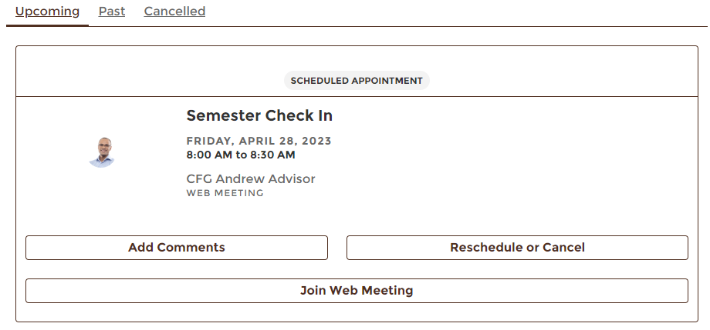
Confirming an Appointment
Confirm appointment topic, time, and support staff
Enter any comments relating to the appointment
Select a location for the appointment
  Virtual appointments are accessed via weblink
  Appointment link available on the SSH homepage

Slide 16
Questions?
Thank you.

