Slide 1
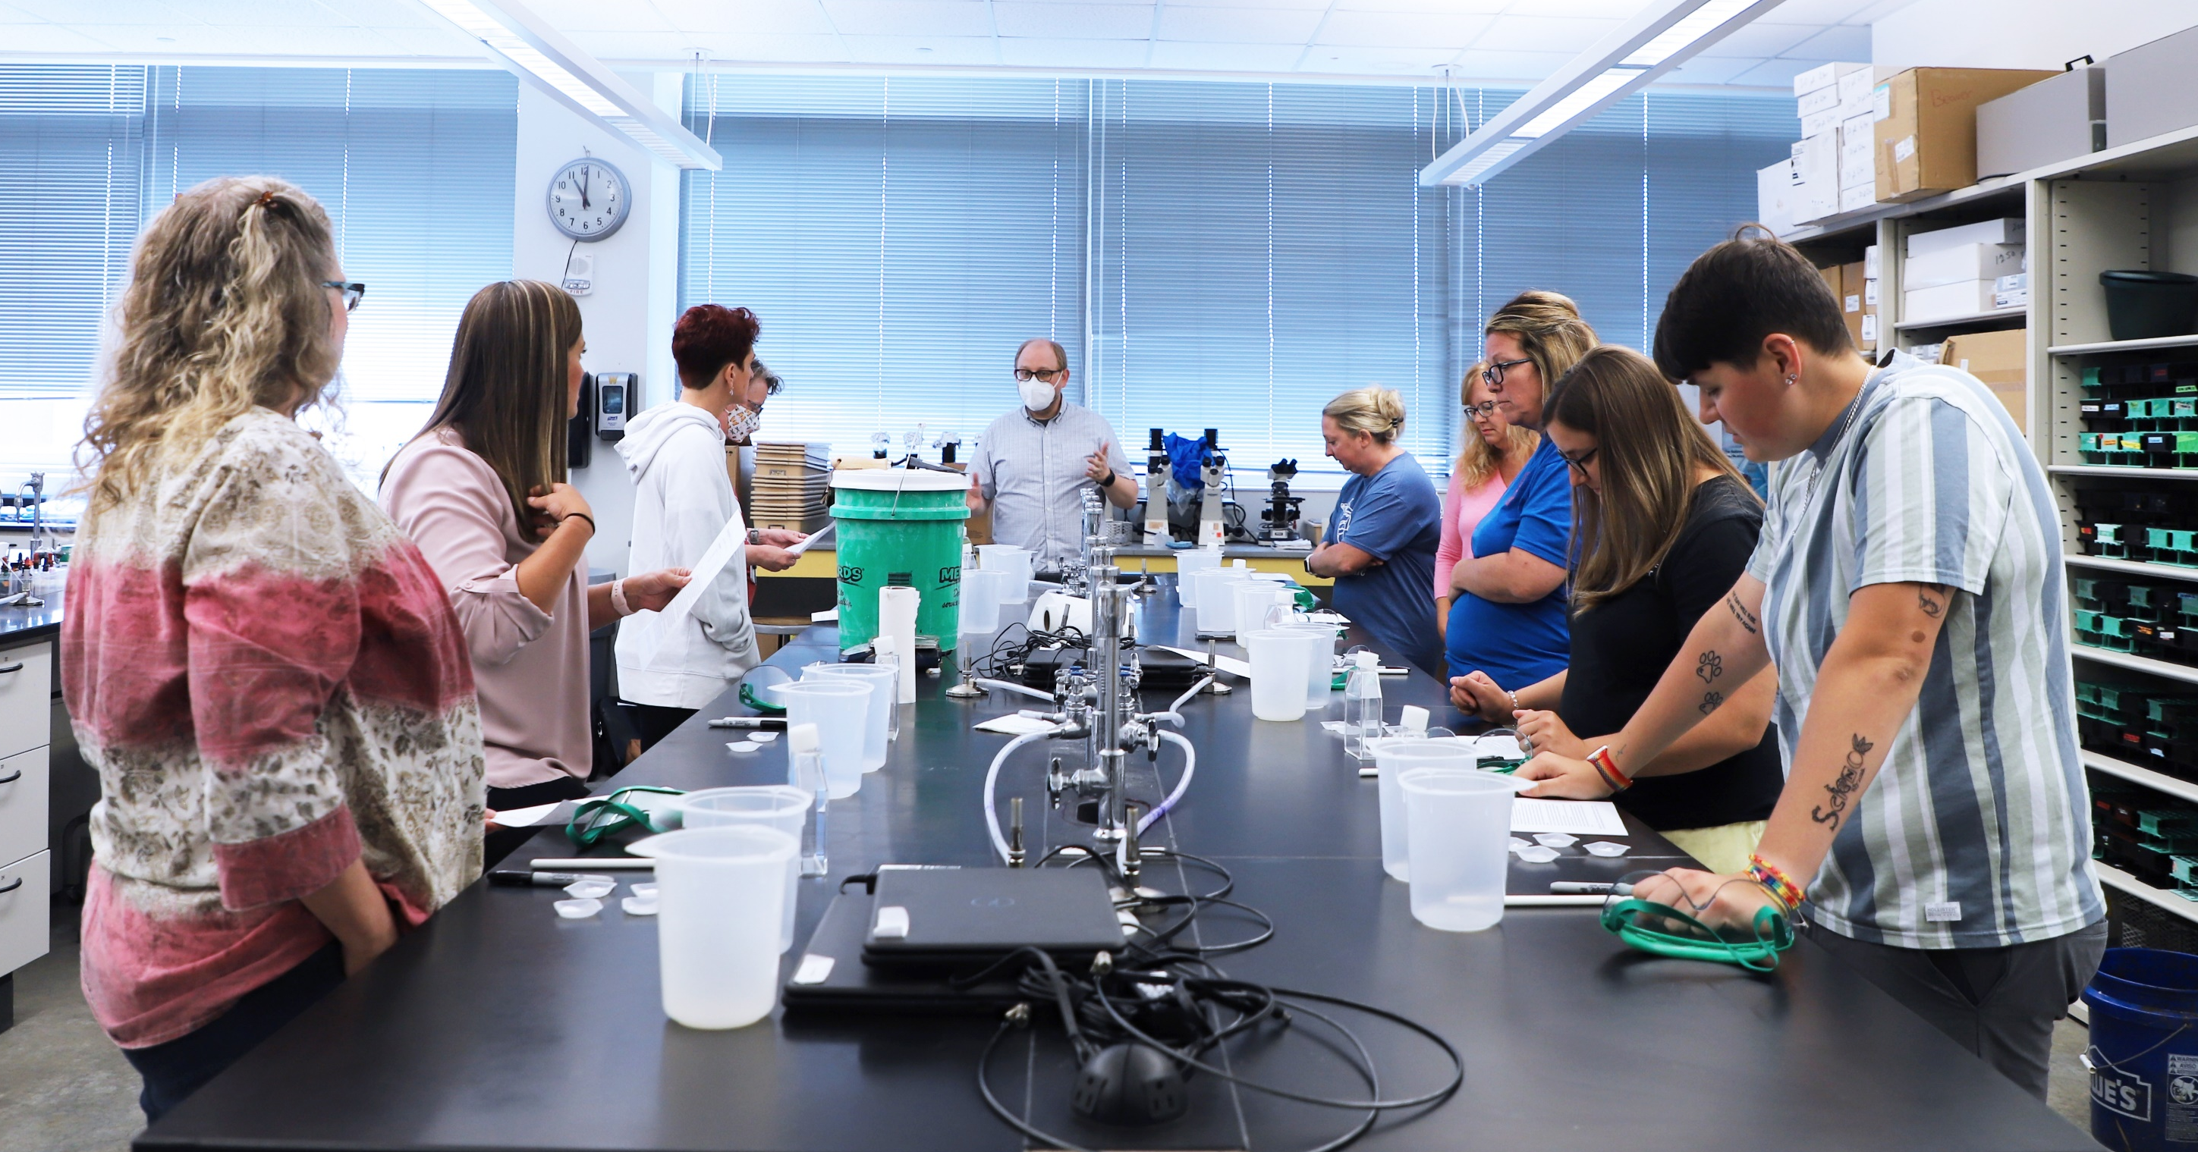
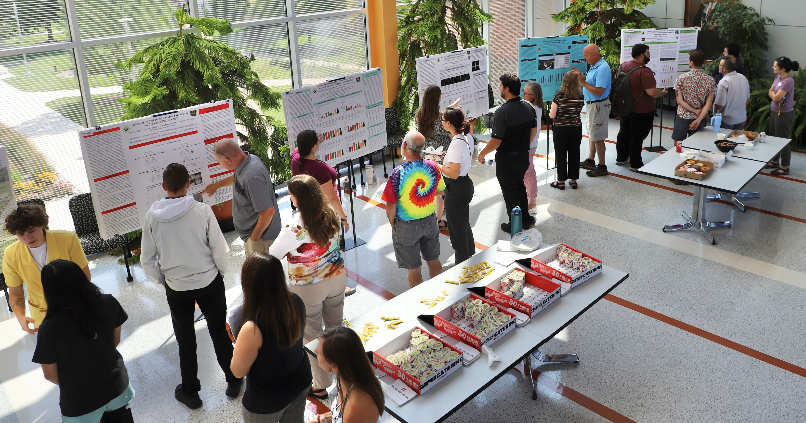


Science Teachers in Southwest Michigan, you are invited to join a National Science Foundation-funded summer research experience in Biological Sciences at Western Michigan University
Program Dates: June 15 - July 31, 2026 Participant Support: $7,840 stipend
Application Deadline: April 3, 2026
Eligibility:
be a citizen, national, or permanent resident of the United States
be able to work ~40 hours per week for the 7-week term
teach or have taught at least one science class at a middle or high school in Southwest Michigan
Program Description
The center piece of the program is a paid 7-week summer experience for 8 teachers from June 15 to July 31, in the laboratories of WMU faculty mentors.
These research projects revolve around a unifying theme: how plants, animals, and microorganisms interact with other organisms and their environments.
The summer research experience will be complemented with faculty research seminars, professional development workshops, demonstrations of hands-on laboratory teaching modules, lunch-time discussions, poster presentations, and a fall semester classroom visit.
Application Information
Please e-mail the following application materials to bios-rets@wmich.edu
  A brief resume;
  A one-page personal statement;
  A filled Teacher Participant Application Form.
Please have a letter of recommendation from your principal sent directly to bios-rets@wmich.edu.
Please visit https://wmich.edu/biology/biorets for more information and downloading the application form.
For assistance, contact the program director Dr. Yan Lu (yan.1.lu@wmich.edu) or co-director Dr. John Spitsbergen (john.spitsbergen@wmich.edu).

