Slide 1


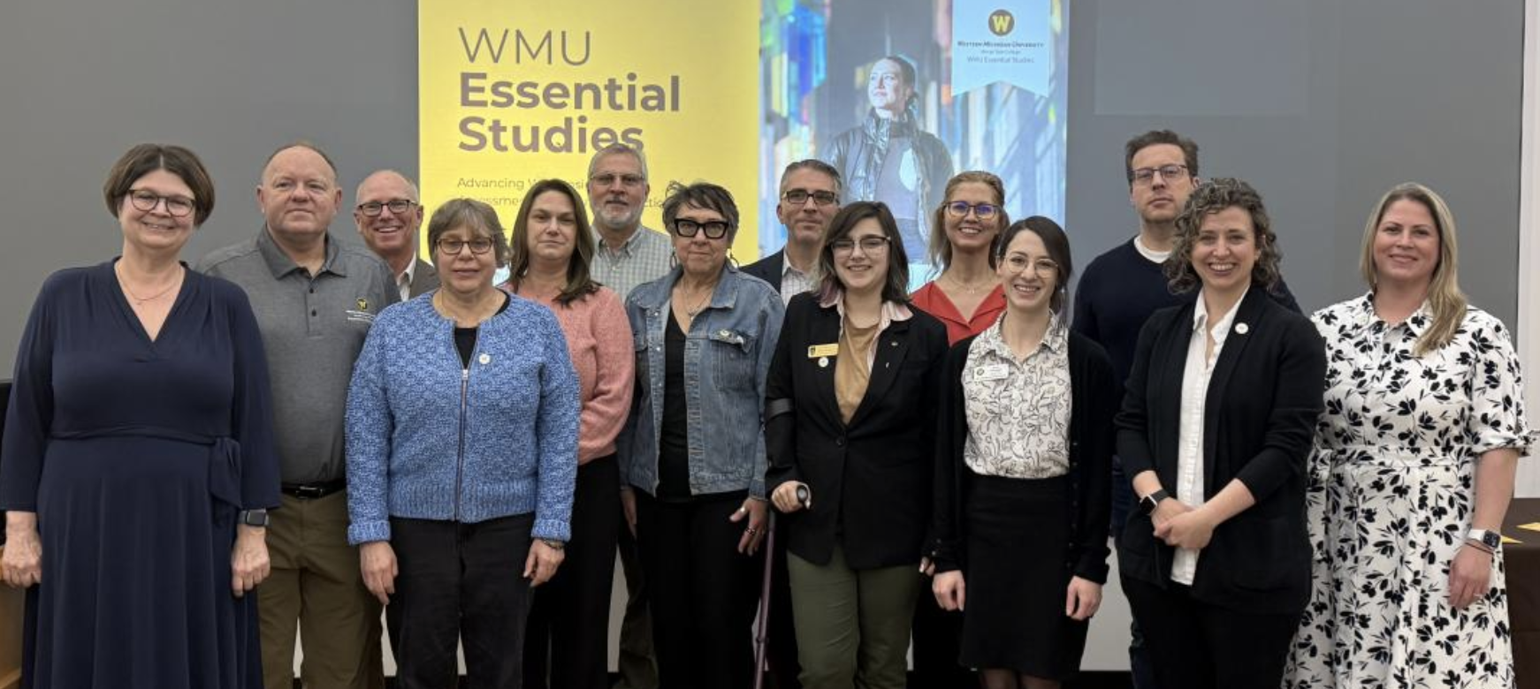
WMU
Essential
Studies
Advancing WES: Insights, Assessments, and Future Directions
Results from the 2024-25 WES Comprehensive Review
Elissa Allen, Chair WES Executive Advisory Committee
Jonathan Bush, WES Faculty Director

Slide 2
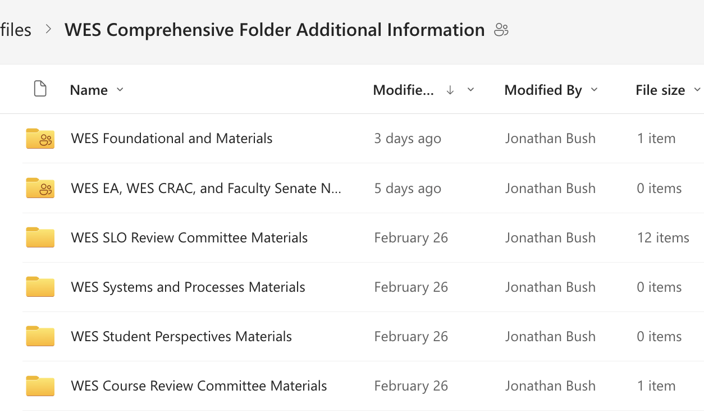
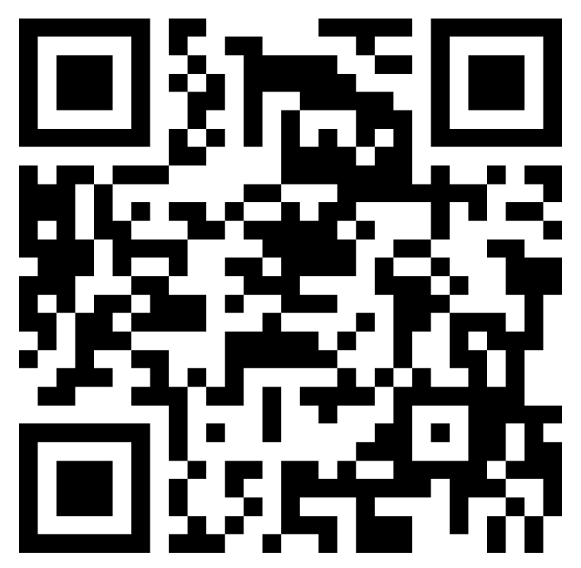
WES Report Archive
The WES review report is publicly available at the 2024-2045 WES Comprehensive Review.
The report includes a link to a SharePoint archive of all materials relevant to each committee's work and kept as a record of processes and data.
https://wmich.edu/essentialstudies/review

Slide 3
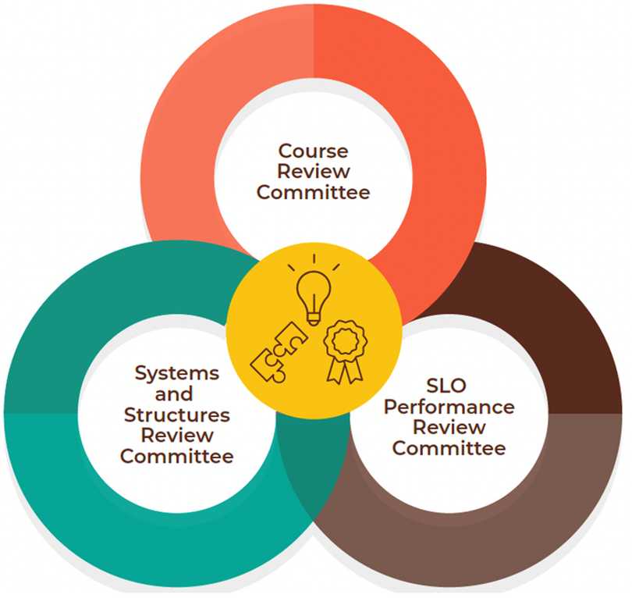
WMU Essential Studies
Review Process
Y1 (2021-22) | Y2 (2022-23) | Y3 (2023-24) | Y4 (2024-25) PROGRAM REVIEW
WRITING | LOCAL/NATIONAL | GLOBAL PERSPECTIVES | Subcommittees review core information
SOCIETIES and CULTURE | SCIENCE/TECH with LAB | ARTISTIC THEORY and PRACTICE | Program review team will include a subcommittee: members of Executive Advisory, CRAC, UG Studies Council
WORLD LANGUAGES/ CULTURES | SCIENCE/TECH | PERSONAL WELLNESS | Program review team will include a subcommittee: members of Executive Advisory, CRAC, UG Studies Council
ORAL/DIGITAL | INQUIRY/ ENGAGEMENT | QUANTITATIVE REASONING | Program review team will include a subcommittee: members of Executive Advisory, CRAC, UG Studies Council
*SUSTAINABILITY and D/I SLOs reviewed during the regular review. | *SUSTAINABILITY and D/I SLOs reviewed during the regular review. | *SUSTAINABILITY and D/I SLOs reviewed during the regular review. | *SUSTAINABILITY and D/I SLOs reviewed during the regular review.
  Academic Year 2025-26 is for review and implementation.
  WES Review cycle begins again in AY 2026-27.

Slide 4
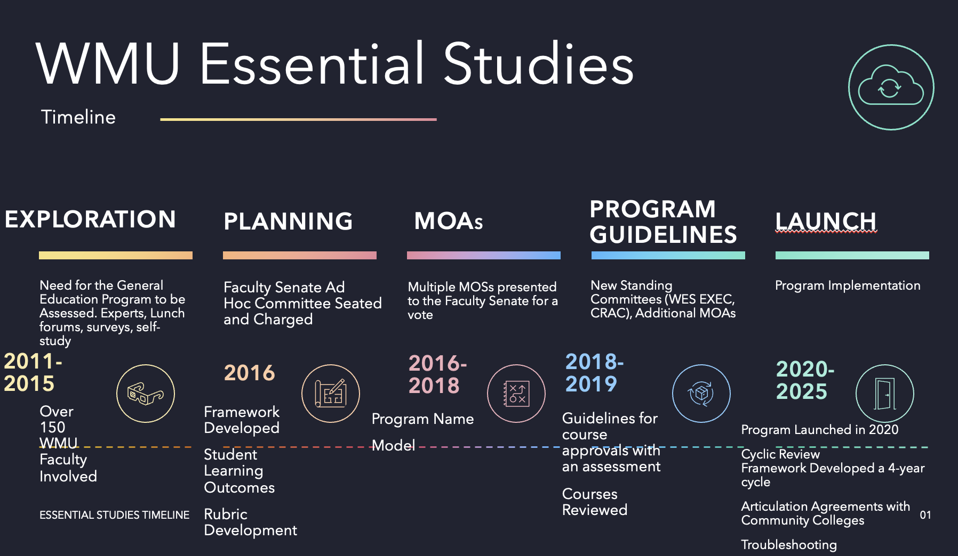
Assessment at the Core: A Brief History of WMU Essential Studies

Slide 5

By-the-Numbers: Spring 2025
Overall WES Course Portfolio
WES Course Enrollment: Spring 2025
TOTAL COURSES: | 364
Level 1 | 79
Level 2 | 196
Level 3 | 89
CAS | 236
CoA | 2
CEHD | 20
CEAS | 22
CFA | 31
CHHS | 27
HCoB | 17
LHC | 9
 | Sections | Enrolled | SCH Produced
TOTAL: | 656 | 21,014 | 66,108
Level 1 | 186 | 5,881 | 18,102
Level 2 | 360 | 12,201 | 38,810
Level 3 | 110 | 2,932 | 9,196
CAS | 370 | 11,682 | 37,568
CoA | 3 | 67 | 201
CEHD | 70 | 1,706 | 4,857
CEAS | 32 | 901 | 2,837
CFA | 32 | 2,039 | 6,651
CHHS | 72 | 2,090 | 6,413
HCoB | 67 | 2,405 | 7,209
LHC | 10 | 124 | 372
WES courses
78% full;
produced 43% of total WMU UG SCH. (66,108/153,968)
Data analysis: Ewa Urban, Ph.D.
Office of Institutional Research

Slide 6
By-the-Numbers: Fall 2025
Overall WES Course Portfolio
WES Course Enrollment: Fall 2025
TOTAL COURSES: | 407
Level 1 | 87
Level 2 | 213
Level 3 | 107
CAS | 258
CoA | 2
CEHD | 24
CEAS | 22
CFA | 35
CHHS | 29
HCoB | 23
LHC | 14
 | Sections | Enrolled | SCH Produced
TOTAL: | 742 | 23,815 | 74,315
Level 1 | 271 | 8,447 | 25,931
Level 2 | 356 | 12,594 | 39,566
Level 3 | 115 | 2,774 | 8,818
CAS | 413 | 12,981 | 41,225
CoA | 6 | 400 | 1,200
CEHD | 74 | 1,853 | 5,265
CEAS | 34 | 894 | 2,814
CFA | 41 | 2,072 | 6,644
CHHS | 81 | 2,638 | 8,112
HCoB | 84 | 2,824 | 8,596
LHC | 9 | 153 | 459
WES courses
78% full
produced 43% of total WMU UG SCH. (74,315/171,283)
Data analysis: Ewa Urban, Ph.D.
Office of Institutional Research

Slide 7
2024-2025 WMU Essential Studies Executive Advisory Committee (WES EA)
Appointed Faculty Members
  Elissa Allen (Vice Chair) (Health and Human Services) (25-26 Chair)
  Decker Hains (Business)
  Elizabeth Isidro (Education and Human Development) (25-26 Vice Chair)
  Lindsay Jeffers Secretary) (Arts and Sciences)
  Lei Meng (Arts and Sciences)
  Brenda Srof (Health and Human Services)
  Brian Tripp (Arts and Sciences) (24-25 Outgoing Chair)
  Kathryn Wagner (Fine Arts)
Appointed Administrative Members
  Jessica Parker (Director, Academic Advising, Merze Tate)
  Luchara Wallace (Dean, Merze Tate)
Advisory Members
  Jonathan Bush (WMU Essential Studies Faculty Director)
  Carrie Cumming (Registrar)
  Lisa DeChano-Cook (Curriculum Manager)

Slide 8
2024-2025 WMU Essential Studies Course Review and Approval Committee (CRAC)
Advisory Members
  Jaquelyn Bizzell
  Nick Gauthier
  Anthony Helms
  Melinda Lockett
  Christine Robinson
  Colleen Stano
  Sharon VanDyken
  Lisa Dechano-Cook
  Jonathan Bush
Ex-Officio
  Decker Haines
  Brian Tripp
Appointed Faculty Members
  Carol Weideman (Chair)
  Kirsty Eisenhart
  Beth Ernst
  Anne-Marie GuidyOulai
  Dana Hammond
  Kwangmin Lee
  Vincent Lyon-Callo
  Matilda McLean
  Mustafa Mirzeler
  Agatha Slupek
  Nathan Tabor

Slide 9
2024-25 WES Review Committees
WES Course Review Committee
WES Systems and Structure Review
Chairs: Linda Borish, Cynthia Klekar-Cunningham
Reviewed all WES courses
to determine placement and status.
Chairs: Megan Hess, Veronica Rice McCray
Broadly reviewed the entire WES
program and processes.
WES SLO Performance Review Committee
WES Student Perspectives (WSA-led)
Chairs: Daria Orlowska, Eli Rubin
Conducted a deep dive into all of
WES SLO performance data to seek relevant
trends and issues.
Chair: Liberty Kostrzwa (with assistance from Randy Ott)
Conducted a survey and focus groups
with WMU students to better understand
student perceptions and knowledge of WES.

Slide 10
Some Key Findings and Outcomes
WMU Essential Studies is mostly working as developed.
The WES Review Cycle is now doctrinal and ongoing.
Processes, procedures, and institutional knowledge all exist to keep it moving forward.
This is the first iteration of the process. This was an accomplishment in itself:
  We built the enduring structure and processes
  We learned new questions to ask
  We learned lessons for the next review.

Slide 11
Some Findings and Outcomes (By Topic)
Course Review
  Over 400 reviewed courses, only 12 were recommended for potential removal.
  Generally, courses are being offered regularly. Less certainty about data collection and review.
Student Learning Outcomes
  Students are performing as expected.
  Flawed data sets hamper detailed understanding (levels, SLOs)
  More review of specific student audiences needed (1st gen, Pell, etc.).
Systems and Structures
  Systems are often too complex, detailed, or ill-defined
  Need to streamline transfer, approval/revision, assessment, and course management procedures.
Student Perceptions
  Students understand the goals of WES and are following the scaffolded model but often choose courses for non-curricular reasons.

Slide 12
Response: Ongoing Improvement Initiatives
One outcome is doing the review
WES EA has begun four ongoing improvement initiatives.
  Revised Assessment Plan Templates and Processes
  Revised/Improved SLO Outcome Rubrics
  Improved Faculty Communication
  Improved Transfer Assessment Process
Notes:
There are currently 17 categories of Student Learning Outcome Rubrics for WMU Essential Studies courses listed on the WMU Essential Studies Outcome Rubrics webpage:
https://wmich.edu/facultysenate/wmuessentialstudies/wesrubrics
This list is a result of decisions made early in the development of WES.
Is this enough categories? Probably.
Do we need some extra category slots for future development?
Some categories have detailed descriptions, others are more minimal (include word count statistics).
Two Outcome Rubrics have identical criteria, Science vs. Science with laboratory. Perhaps lab should have a separate assessment component.
Two Outcome Rubics are identical, one is not used in Curriculum/Curriculog?
As originally envisioned, each category of Outcome Rubric should be available to use by any unit or department across campus, regardless of their academic focus.

Slide 13
Key Initiative #1: Assessment and Review Processes
Issue/Need
Assessment Plan Templates can be confusing and hard to use
Poor/contradictory instructions for faculty
No differentiation between large and small course revisions in process
Cyclic Review process is poorly defined
Results
Too many rejected new courses or revisions
Current Initiatives
New Assessment Plan Procedures and Guidelines:
broad assessment, more instructor agency
Redeveloped cyclic review process
Revised CRAC operations
Improved faculty communication
UPDATE:
Thanks to 2025-2026 CRAC Chair, Katherine Suender and the current committee, CRAC approved 100% of submitted courses in Fall 2025.
Standards were not lowered. The committee collaborated with faculty on proposals and gave opportunity to revisions during the review.

Slide 14
Key Initiative #2: Outcome Rubric Review
Issue/Need
Some discrepancies/major variances in SLO outcome rubrics leads to confusion
  Some are very short; others are highly detailed
  Some include Outcome choices; others are controlled.
  SSL: Scientific Literacy and “With a Lab:” two categories with same rubric
  IFKL: Two versions, same SLO: "Humanities" and "Social Sciences"
Current Initiatives
Reviewing all Outcome Rubrics to (1) simplify and (2) standardize Outcome Rubrics.

Slide 15
Key Initiative #3: Faculty Communication
Issue/Need
Current faculty resources are scattered and confusing.
No comprehensive and easy-to-access source. Faculty need to go to multiple sites (Merze Tate and Faculty Senate) to find various information
Information is incomplete and contradictory
Result
Confusion regarding faculty obligations and procedures
Incomplete faculty understanding of WES goals and structures
Current Initiative
2025-2026 WES Faculty Fellow Professor Beth Ernst is creating a comprehensive communication plan and infrastructure for all instructors, including user-friendly WES Faculty website (One-Stop Shop" dashboard for all faculty and advisor information).
UPDATE:
WES faculty website is underway, with plans for soft-launch in early Spring 2026 and full launch by end of Spring 2026 semester.

Slide 16
Key Initiative #4: WES Transfer Evaluations
Issue/Need
Poorly articulated process for granting WES credit for transfer students
Advisors/Advising Directors had to make decisions without guidance
Departments tasked to make WES decisions beyond their scope
Result
Inconsistent transfer credit
Slow and ill-defined process
Advisor and faculty confusion
Current Initiative
New WES Transfer protocol now in place.
Approved by Advising Director Council and WES EA
Provides immediate processes for individual transfers, process for adding to TES, and faculty oversight.
UPDATE:
WES Transfer protocol is now approved by both advising directors and WES EA.
Process allows immediate transfer credit for incoming students and faculty oversight via WES EA for ongoing approval and inclusion in TES.

Slide 17
The Next WMU Essential Studies Review Process
Y1 (2025-26) | Y2 (2026-27) | Y3 (2027-28) | Y4 (28-29) PROGRAM REVIEW
 | WRITING LOCAL/NATIONAL | GLOBAL PERSPECTIVES ORAL/DIGITAL | Program review team will include a subcommittee: members of Executive Advisory, CRAC, UG Studies Council
IMPLEMENTATION YEAR | SCIENCE/TECH with LAB WORLD LANGUAGES/ CULTURES | SOCIETIES and CULTURE ARTISTIC THEORY and PRACTICE | Program review team will include a subcommittee: members of Executive Advisory, CRAC, UG Studies Council
 | SCIENCE/TECH | PERSONAL WELLNESS | Program review team will include a subcommittee: members of Executive Advisory, CRAC, UG Studies Council
 | INQUIRY/ ENGAGEMENT | QUANTITATIVE REASONING | Program review team will include a subcommittee: members of Executive Advisory, CRAC, UG Studies Council
*PSL and DIL SLOs reviewed during the regular review. | *SUSTAINABILITY and D/I SLOs reviewed during the regular review. | *SUSTAINABILITY and D/I SLOs reviewed during the regular review. | *SUSTAINABILITY and D/I SLOs reviewed during the regular review.
  Academic Year 2025-26 is for review and implementation.
  Cyclic review occurs over two AY.
  WES Review cycle begins again in AY 2026-27.
  Next WES Comprehensive Review will occur in AY 2028-29.

Slide 18
WES Report Archive
The WES review report is publicly available at the 2024-2045 WES Comprehensive Review.
The report includes a link to a SharePoint archive of all materials relevant to each committee's work and kept as a record of processes and data.
https://wmich.edu/essentialstudies/review

