Slide 1

Faculty Research and Creative Activities Award (FRACAA) Workshop
Andre Venter Joanne Mih
andre.venter@wmich.edu joanne.mih@wmich.edu
Dec 5, 2025
Notes:
Andre Venter professor in chem longstanding RPC member and past chair
Joanne Mih, Program officer and manangewr of internal funding at ORI

Slide 2
FRACAA Workshop
Overview of FRACAA, including goals, deadlines, eligibility, and award conditions
Budget, including limits, fundable activities, and restrictions
Proposal components and specifications
Proposal evaluation criteria and mechanics
Support for proposal preparation

Slide 3
Overview
Goals of FRACAA:
Encourage and support faculty in research, scientific inquiry, original artistic activity and inventive technology
Increase external funding at WMU in support of faculty scholarship
Award limit:
$10,000
Funding:
Current budget allows for funding of 10 proposals
Success rate was ~25% in 2025
10 awarded out of 42 submitted
17 were recommended for funding without reservation
Notes:
FRACAA awards are made up to a maximum of

Slide 4
Funding rates by Category
Category | Submitted | Funded | Success Rate
Quantitative Sciences | 26 | 5 | 19%
Qualitative Scholarly | 9 | 3 | 33%
Creative Arts | 7 | 2 | 28%
College | Submitted | Funded | Success Rate
CEAS | 12 | 2 | 16%
CAS | 17 | 4 | 24%
CHHS | 2 | 0 | 0%
CEHD | 5 | 2 | 40%
CFA | 6 | 2 | 33%
Faculty Rank | Submitted | Funded | Success Rate
Assistant Professor | 11 | 3 | 27%
Associate Professor | 12 | 3 | 25%
Full Professor | 18 | 3 | 17%
MFS-Lecturer | 1 | 1 | 100%

Slide 5
Important Dates
FRACAA submissions accepted for 2026-27 cycle as of December 1, 2025, at https://wmich.infoready4.com
Submission deadline: February 9, 2026
Award notification: End of April 2026
Program year: June 15, 2026 - June 14, 2027
Final project report: due within 90 days of project termination date

Slide 6
Eligibility
Principal Investigator (PI) must be board-appointed faculty (member of bargaining unit) at time FRACAA proposals are due
PI whose WMU appointment terminates prior to or during program year may submit an application, but no award will be made until there is an appointment at WMU covering entire program year
Previous FRACAA awardees are eligible once they have satisfied requirements of prior award as there is no longer a 3-year waiting period to apply.

Slide 7
Award Conditions
FRACAA awardees are required to:
Submit a progress report midway through the program year and a satisfactory final report within 90 days of project termination date
Present their findings at the designated ORI FRACAA Poster Presentation (usually the Spring Convocation) within one year of project termination date
Submit a proposal to an external funding source within 18 months of project termination date
Be prepared to review FRACAA proposals in future

Slide 8
Typical Budget Categories
Student research assistance or student help
Travel to conduct project activities
Supplies
Equipment
Professional Services
Faculty release time at Part-time instructor rate
During academic year only
May not be used to pay the PI overtime

Slide 9
Budget Restrictions
Faculty salary not allowed
Tuition or other education/training expenses
Projects solely for student research and creative activities
Travel for presenting research and creative activity
Professional services in violation of above budget restrictions
Budget requests exceeding $10,000 limit

Slide 10
Proposal Components and Specifications
Proposal to be submitted under one methodological category, as designated by PI:
Quantitative Sciences
Qualitative Scholarly
Creative Arts

Slide 11
Proposal Components and Specifications
Proposal to be written for general faculty comprehension
Anonymity No longer enforced. No need to self-identify or redact ID
Proposal consists of the following sections:
Proposal narrative (7 pages max, 12 pt font, 1” margins)
Budget worksheet and justification (2 pages max, must use form provided)
References list (from proposal narrative; no page limit)
Other supporting documents (only if absolutely necessary to illustrate project can be completed; 2 pages max)

Slide 12
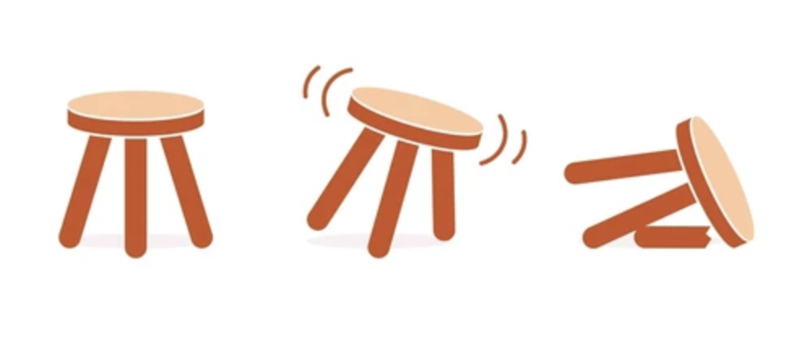
Proposal Evaluation Criteria
FRACAA grants are awarded solely on the basis of eligibility and proposal merit
FRACAA proposals are evaluated on the following criteria:
Merit of the proposed activity (WHAT)
Context of the project (WHY)
Project procedure and planning (HOW)
Once an applicant is deemed eligible, at least three members of the FRACAA Research Screening Committee will review the entire proposal for merit based on these criteria

Slide 13
Context of the Project
Proposal is clearly written for an audience of peers and professionals, yet non-specialist
Proposal makes a strong case that activity will make a meaningful contribution within its own field
Activity will address a broad scholarly issue
Adequately describes steps to be taken in order to secure external funding

Slide 14
Project Procedure and Planning
Methods are clearly stated and appropriate for proposal
Timeline is clear (be explicit)
Data analysis/evaluation is planned and appropriate
Proposal details access to appropriate resources, equipment, facilities needed to complete activity
Costs for proposed budget are clearly itemized and justified (using university guidelines when available)

Slide 15
FRACAA Screening Committee
Faculty colleagues review proposals outside of their direct field of expertise and department.
Panels are divided into methodological categories:
Creative Arts
Qualitative Scholarly
Quantitative Sciences
Each panel includes 3 or 4 reviewers
Multiple panels for categories with many proposals
Selected based on avoiding conflicts of interest
With appropriate background to understand the proposals

Slide 16
Mechanics of review process
Each panel/reviewer is assigned 4 to 6 proposals to review
Each panel appoints a panel chair
Chair sets up a panel meeting
Reviewers discuss the proposals and reviews, then make a panel funding recommendation for each proposal
The panel will also rank the proposals it has reviewed
All the proposals are then ranked based panel scores and on individual reviewer scores.
Top 10 are funded.

Slide 17
Additional Support
The FRACAA website provides detailed information on submission requirements and all other aspects of FRACAA: https://wmich.edu/research/funding/internal/fracaa
FRACAA applicants have access to a Mentors Program, including quick reads and suggestions on your proposal
Please direct any questions to Andre and/or Joanne
joanne.mih@wmich.edu
andre.venter@wmich.edu

