Slide 1


Graduate Assistantship (GA) Orientation
Research and Innovation

Slide 2
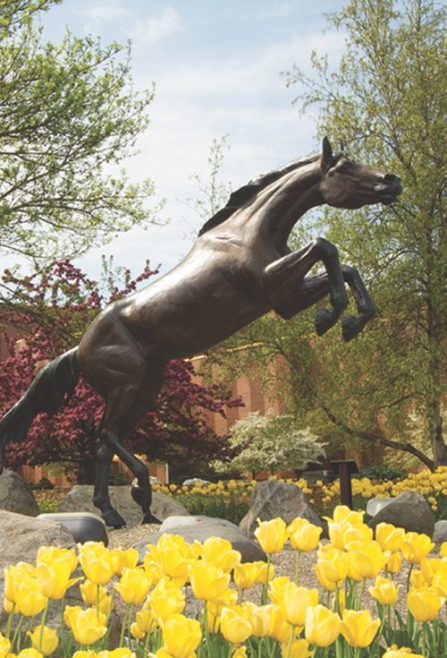
Western Michigan University
Julia Mays
Director
Research Compliance
Denise Wheatley
Associate Director
Research Administration Pre-Award
Research and Innovation

Slide 3

Research Compliance
Chief administrator overseeing the conduct of research to promote integrity and maintain compliance with regulations
Institutional Review Board (WMU IRB)
Institutional Animal Care and Use Committee (IACUC)
Institution Biosafety Committee (IBC)
Provide required training in responsible conduct of research, research security, human subjects research, and animal used in teaching and research
WMU administrator for The Collaborative Institutional Training Initiative (CITI Program)
WMU administrator for ClinicalTrials.gov Protocol Registration and Results System (PRS)
WMU Administrator for Cayuse IRB
https://wmich.edu/research/compliance

Slide 4
Research Compliance
All research done under the aegis of Western Michigan University must adhere to federal, state, and local regulations, along with University policies.
Much of the research (human subject, animal, biohazards, genetic materials, or nuclear materials/radiation, and international) faculty, students, and staff may be engaged in requires oversight/approval from the appropriate University board/committee/official. The policies of the University and committees providing oversight are based on the federal and state regulations governing the research, along with best practices.
Approval must be obtained prior to implementing the research project.
There are no exceptions to this requirement.
In addition, some research requires a training component that must be completed before the project can be approved.

Slide 5

Institutional Review Board (WMU IRB)
Charged with protecting the rights and welfare of humans participating in research as the subject of that project.
The WMU IRB Board includes faculty/staff from different disciplines, along with non-affiliated community members that represent the Kalamazoo area.
3 Categories of review (exempt, expedited, full)
Exempt/Expedited submitted any time revolving review.
Full must be submitted by 1st Wednesday to be reviewed at meeting on 3rd Wednesday; Researchers invited to attend.

Slide 6




Are you planning to do any of the following?
Now that the consent document has been signed…we can begin the interview for my research study.
Thanks for explaining the risks and benefits of your research study.
I agree to participate.
Conduct a survey
Interview individuals
Observe behaviors of individuals
Implement an intervention involving people
Analyze data about individuals
Engaging in any of the mentioned or similar activities
Visit our website at https://wmich.edu/research/compliance/wmuirb
or contact the Director Research Compliance or the WMU IRB Analyst
wmu-irb@wmich.edu
Research and Innovation

Slide 7
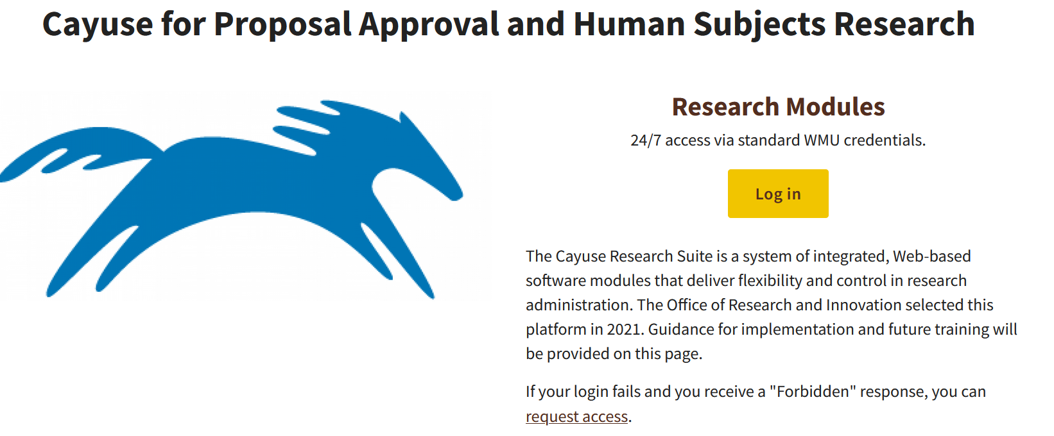
When conducting a human subject research project…
Projects must be reviewed/approved by the WMU IRB prior to implementing
All protocols must be submitted through the Cayuse online platform
Students must request access to Cayuse
  Contact Research Compliance
  Provide your full name, WIN number, WMU email and BroncoNet ID
https://wmich.edu/research/contact
Or
Wmu-irb@wmich.edu

Slide 8
The Institutional Animal Care and Use Committee (IACUC)
A local review board, charged with the ethical care and use of animals in teaching and research.
The WMU IACUC includes faculty/staff from disciplines that work with animals in teaching and/or research, along with non-affiliated scientist and non-scientist from the Kalamazoo area.
Protocols may be submitted any time and are reviewed the second Wednesday of each month.

Slide 9
Institutional Biosafety Committee (IBC)
No activity involving the construction or handling of recombinant or synthetic DNA molecules or organisms and viruses containing recombinant or synthetic DNA molecules shall be initiated without prior notification, and if necessary review and approval of the WMU Institutional Biosafety Committee (unless specifically exempt as described in the regulations).
The WMU IBC includes faculty and staff that are experts in biosafety and containment, persons knowledgeable in institutional policies, applicable laws and regulations, at least one laboratory staff member, at least one animal and one plant expert, along with non-affiliated members reflecting the community attitudes.
Protocols registered and approved at annual IBC meeting.

Slide 10

Radiation Safety
Federal and State of Michigan rules and regulations require WMU to assure that exposure to radiation is as low as reasonably achievable.
Common uses include electron microscopy, x-ray diffraction, accelerator research, DNA and protein labeling, DNA hybridization, and enzyme assays
People using RAM and/or radiation producing machines are exposed to low of radiation.
Michael Center Radiation Safety and Export Control Officer
269-387-5933

Slide 11

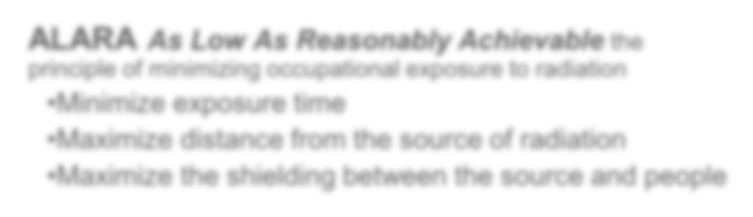



ALARA As Low As Reasonably Achievable the principle of minimizing occupational exposure to radiation
Minimize exposure time
Maximize distance from the source of radiation
Maximize the shielding between the source and people
Radiation Services provided:
  Training
  Exposure monitoring and surveys
  Placement of ALL material orders
  Transportation of ALL materials
  Liaison with regulatory agencies
  Emergency response
Visit our website at http://www.wmich.edu/research/compliance/radiation
or contact WMU’s Radiation Safety Officer 269-387-5933
Office of Research and Innovation

Slide 12

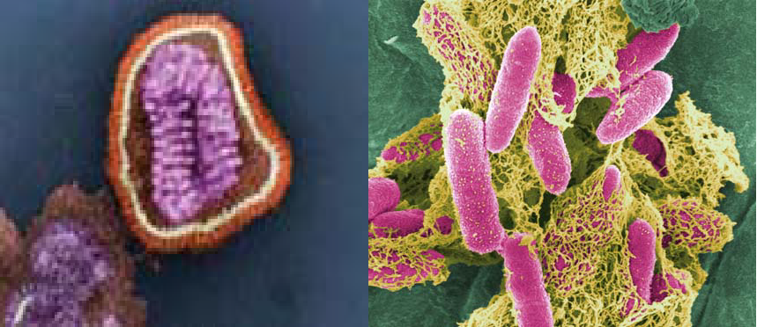
Using Microbial Agents and their Products OR Engaging in Research Involving Recombinant and Synthetic DNA?
Difference between Microbial Agents and Recombinant or Synthetic DNA/RNA:
  Recombinant DNA is genetically-engineered molecules formed by splicing fragments of DNA/RNA into a recipient (host) cell that can then replicate.
  Microbial agents are any potentially pathogenic microorganisms and/or their products.
Biosafety and Security services provided:
Training
Placement of ALL microbial agent orders
Assist in the transportation of microbial agents
Liaison with regulatory agencies
Emergency response
  Recombinant and Synthetic DNA services provided:
    Review and Approval of ALL projects
    Institutional Biosafety Committee (IBC) oversight of projects
    Liaison with regulatory agencies
    Emergency response
Visit our websites http://www.wmich.edu/research/compliance/biosafety/dna Or
http://www.wmich.edu/research/compliance/biosafetymicrobes
or contact WMU’s Director Research Compliance 269-387-8293
Office of Research and Innovation

Slide 13
Export Control
Federal laws that prohibit the unlicensed export of certain commodities or information for reasons of national security or protections of trade. Export controls usually arise for one or more of the following reasons:
The nature of the export has actual or potential military applications or economic protection issues.
Government concerns about the destination country, organization, or individual.
Government concerns about the declared or suspected end use or the end user of the export.

Slide 14

Are you planning to do any of the following?
This is the piece.
The LAST piece! Must remember it and send
the info!
Giving a tour through research labs that have controlled items
Having a sidebar conversation with a foreign person during a conference
Going on international travel in relation to duties/activities with your WMU employment
Conducting research that will have restrictions on publication
Hosting an international visitor
Shipping/transporting/carrying an item into a foreign country
Sending an email to a foreign colleague or person
Providing informal review comments or inputs of an unpublished paper/article for a foreign colleague
Carrying non-commercial encryption software on your computer outside of the U.S.
Working on a project that could have commercial and military uses
Paying or providing an honorarium, a stipend, or per diem to a foreign person from a sanctioned country
Engaging in any of the mentioned or similar activities
Visit our website at http://www.wmich.edu/research/compliance/exportcontrol
or contact WMU’s Research Export Control Officer ovpr-export-control@wmich.edu
Office of Research and Innovation

Slide 15
Research Compliance - Training
All individuals working on an IRB or IACUC protocol must complete the appropriate courses required through the Collaborative Institutional Training Initiative (CITI) program.
Responsible Conduct of Research Training (RCR)
Individuals working on some funded project must complete a course in the Responsible Conduct of Research.
You must take the RCR course that aligns with the funded project.
A course in Research Security is required by some federal sponsors.

Slide 16
Research Non-Compliance
It is important to note that projects requiring review and approval of the IRB, IACUC, and/or IBC may not be implemented until approvals are obtained; failure to do so will lead to an investigation for potential research misconduct.
Investigations for student research misconduct is conducted Student Affairs. Research Compliance will assist in data gathering for the inquiry.
Data collected without the appropriate approvals cannot be used for any purpose.
For human subject research you may not recruit individuals that participate in your study prior to IRB approval.

Slide 17
Research Compliance Contact Information
Research Compliance
(269) 387-8293
Email: julia.mays@wmich.edu
WMU IRB
Email: wmu-irb@wmich.edu
IACUC - IBC
Email: research-compliance@wmich.edu
Export Control
Email: ovpr-export-control@wmich.edu
Export Control/Radiation Safety Officer
Michael Center
(269) 387-5933
Email: michael.j.center@wmich.edu

Slide 18

WMU IRB RESOURCES
 |  | Web Links
 | Human Subjects Research Protection and the Institutional Review Board Policy Human Subject Guidance | https://wmich.edu/policies/human-subjects-research-protection https://wmich.edu/research/compliance/wmuirb
 | Institutional Animal Care and Use Committee | https://wmich.edu/research/compliance/animals
 | CITI Training Website WMU IRB CITI Training Information Agency-Required Training | https://www.citiprogram.org WMU IRB CITI Registration Guidance RCR Training Registration Guidance
 | Cayuse – IRB Submissions Guidance | Cayuse How-Tos https://wmich.edu/research/cayuse-irb
 | Radiation Safety | https://wmich.edu/research/compliance/radiation
 | Export Controls | https://wmich.edu/research/compliance/exportcontrol
 | Biosafety Institutional Biosafety Committee | https://wmich.edu/research/compliance/biosafety https://wmich.edu/research/compliance/biosafety/dna

Slide 19


We are here to help!
Contact us EARLY and OFTEN!!
Research Compliance
https://wmich.edu/research/compliance
387-8293
Walwood Hall
741 Oakland Drive (physical address)

Slide 20
Questions and Comments

