Slide 1
Welcome to the Office of Research and Innovation
Research Discovery (RD)
Graduate Appointees Orientation
August 28, 2025

Slide 2
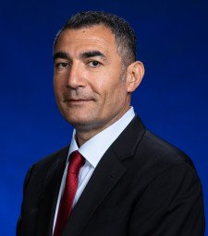
Office of Research and Innovation
Remzi Seker, PhD
Vice President for Research and Innovation
We are a service organization
Support WMU faculty, staff, and students engaged in research and innovation

Slide 3
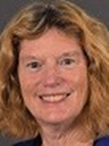


What We Do
Betty McKain
Senior Director Research Administration
Denise Wheatley,
Assoc. Dir. Research
Administration
Pre-Award
Research and Sponsored Programs
  Proposal preparation and submission
  Contact us as soon as you start thinking about a proposal submission
Grants and Contracts
  Post-award financial services
  Contact us if you have questions about allowable expenses on a funded grant or contract
Research Development
  Collaboration and capacity building
  Contact us if you have questions about training opportunities or are looking for collaborators
Technology and Innovation Advancement
  Intellectual property, commercialization
  Contact us if you think your research may have commercial applications
Shellie Mosher,
Assoc. Dir. Research Administration
Post-Award
Christine Stamper,
Research Development Administrator
David Johnson,
Dir. Technology and
Innovation Advancement

Slide 4

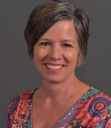
What We Do
Research Compliance
  Oversees research to ensure integrity, safety, compliance with regulations
  Contact us before starting any research involving humans, animals or an international component
Research Contracts
  Reviews, drafts and negotiates contracts and agreements, including non-monetary agreements
  Contact us before negotiating any contracts or signing any agreement*
The Evaluation Center
  Advances the theory, practice and utilization of evaluation
  Contact us with questions regarding program evaluation
Julia Mays
Director, Research Compliance
Christopher Leasure II
Research Contracts
Administrator
Lori Wingate PhD
Exec Dir, Evaluation Center
* Only very specific individuals have authority to sign agreements at WMU.

Slide 5
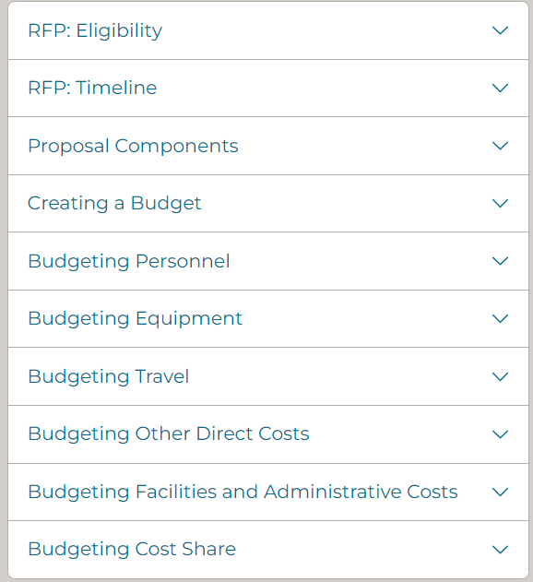
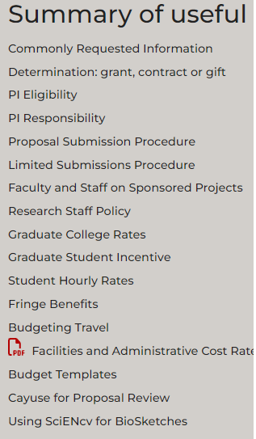
Tools are available on our website!
https://wmich.edu/research/proposals

Slide 6
Applying for funding
  Funding can help you:
    expand your research,
    support travel to conferences, and
    supplement your graduate education beyond your assistantship.
  Professional development – grantsmanship is an important skill. Start developing it now.
  Recognition of your work and your accomplishments

Slide 7
Finding Funding
  Internal funding opportunities
    Graduate College
    Your college or department
  External funding opportunities
    Federal sponsors
    Industry
    Foundations
    Professional organizations

Slide 8
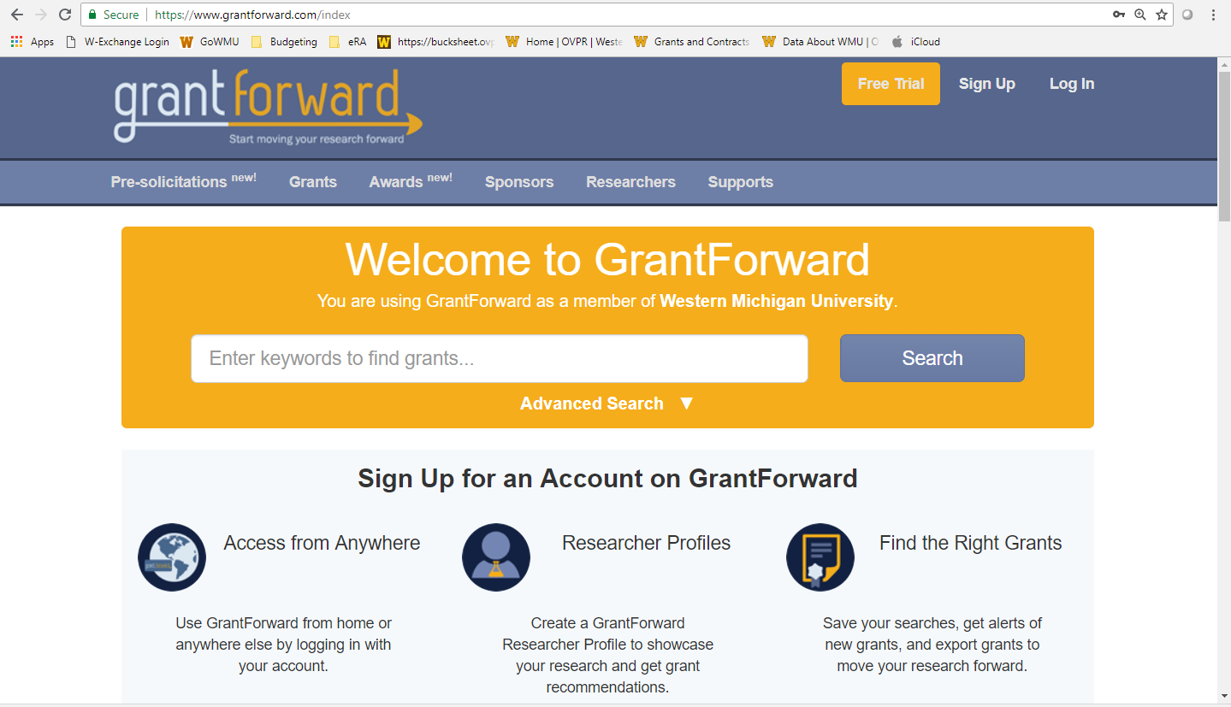
Finding Funding: Resources
https://wmich.edu/research/grantforward

Slide 9
Finding Funding
Establish your search criteria
What level (new graduate student, dissertation, postdoc)
What are you funding (research project, travel, dissemination)?
What problem or need are you addressing?
Who will benefit from your project?
What is the geographic area of the project?
How much funding do you need?
How long will it take to fully develop the project?
When do you want to start the grant?

Slide 10
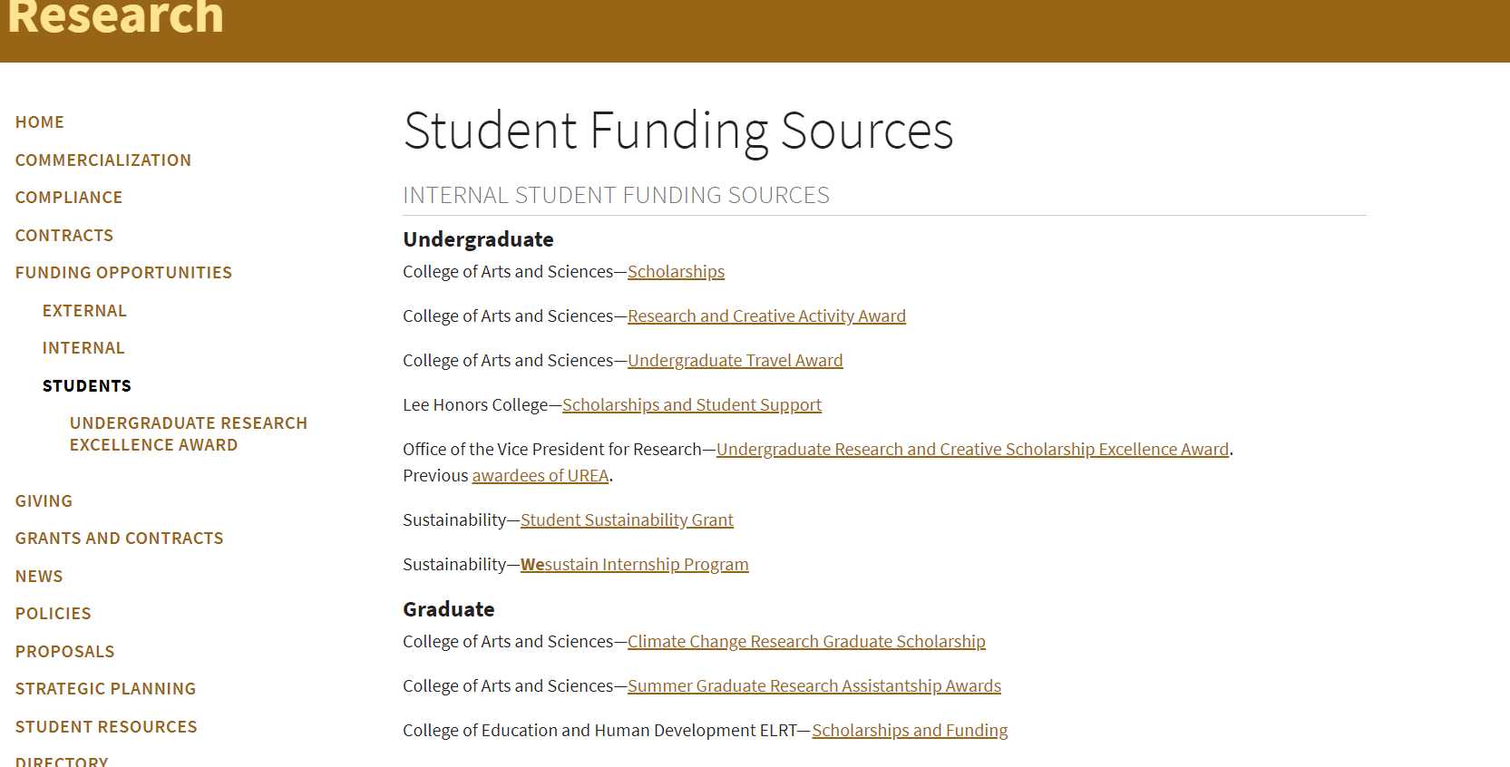
Finding Funding: Resources
ORI website
https://wmich.edu/research/funding/students

Slide 11
Read the guidelines
Who is the applicant?
    Western Michigan University?
    You?
Who is the PI (Principal Investigator)?
    Faculty advisor?
    You?
Other eligibility criteria
Budget limits and allowable (and unallowable) costs
Review Criteria
Submission process (electronic portal, email, other)

Slide 12
When WMU is the applicant
All proposals submitted on behalf of WMU require appropriate University approvals PRIOR to submission
Proposal Approval Form (PAF)
  Allow at least 7 business days for approvals, so start early!
  Faculty will be required to serve as PI (at least for internal purposes)
  https://wmich.edu/research/cayuse
  Login to VPN before accessing if working off-campus

Slide 13
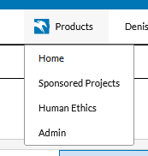
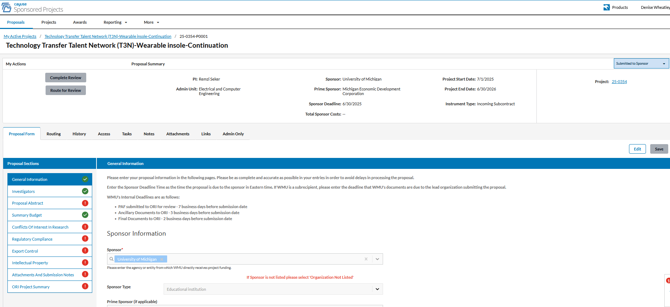

Slide 14



We are here to help!
Contact us EARLY and OFTEN!!
www.wmich.edu/research
269-387-8298
Walwood Hall
741 Oakland Drive (physical address)
EMAIL anyone directly
Research Officers – The first people to contact!

Slide 15


