Slide 1

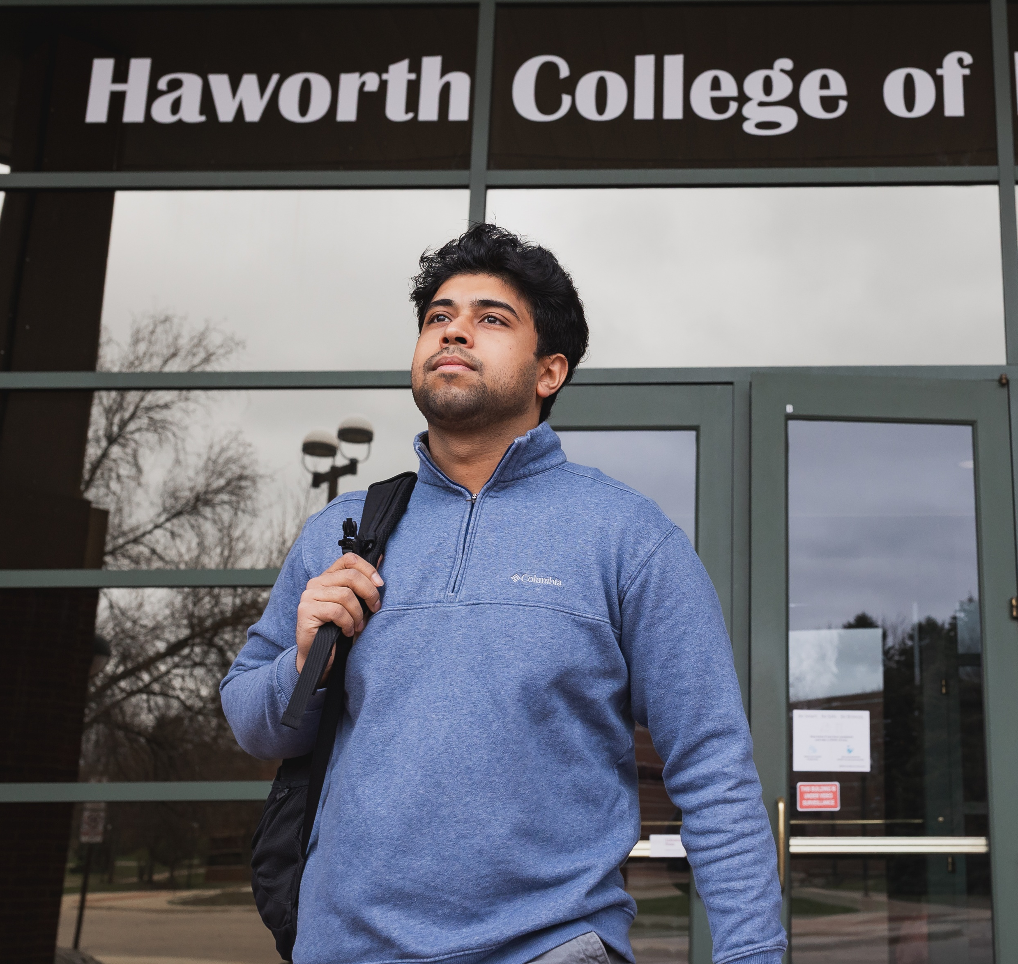
HEADING
Subheading
At Western, we are re-defining success as we expand what it means to be smart in an ever-changing world. Beyond preparing you for your career, perhaps the most special thing about Western is our approach to helping you find a deeper meaning and a better way of thinking. We believe a great education is about more than getting an A on an assignment. It’s about also having purpose and creating a life well lived. Beyond book smarts, your potential lies in your pursuit of purpose and ability to thrive in all areas of life while also reaching your highest professional goals.
Date:
Time:
Place:

