Slide 1


Graduate Assistant (GA) Orientation
2025-26

Slide 2

Presentation Goals
1
2
3
4
Introduce the Graduate College and services
Review the role of a GA at WMU
Provide relevant policies, procedures, and best practices
Guide GAs towards additional training resources and campus services

Slide 3
Graduate Student Online Orientation
wmich.edu/grad
Review prior to this training, not mandatory
Available to all graduate students on the Graduate College homepage at wmich.edu/grad
Self-paced, resource on many helpful topics

Slide 4

Graduate College: Welcome & Overview
Dr. Christine Byrd-Jacobs, Dean

Slide 5
Graduate Education at WMU

Slide 6
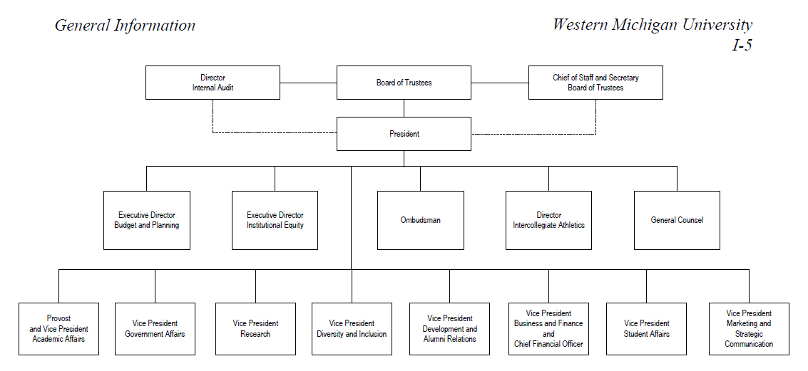
College Deans
College of Arts and Sciences
College of Fine Arts
Haworth College of Business
Department Chairs
College of Aviation
College of Health and
Human Services
Lee Honors College
College of Education and Human Development
College of Engineering and Applied Sciences
Graduate College
Merze Tate College
Faculty/Staff/Students

Slide 7
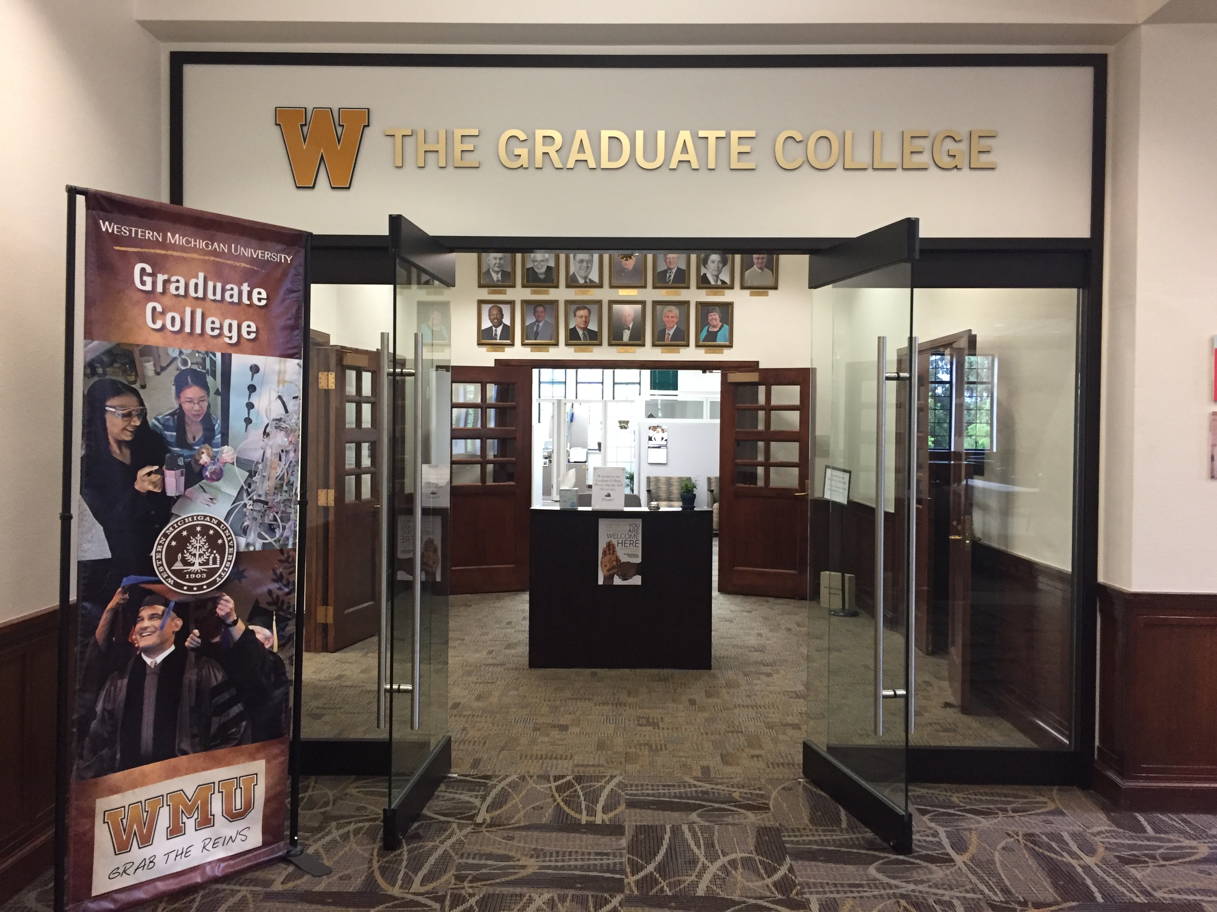
We’re Here to Support You
Advocacy
Graduate appointments
Awards & fellowships
Thesis & dissertation formatting
Forms & processes
Responsible Conduct of Research (RCR)
Policies & guidelines related to graduate education
Events, including 3MT Competition
Student resources for success

Slide 8





Stay Informed
wmich.edu/grad
grad-info@wmich.edu
@WesternGradCollege
@wmugradcollege
@wmugradcollege
Grad student newsletter

Slide 9
Graduate Assistants:
Roles and University Policies
Dr. Christine Byrd-Jacobs, Dean

Slide 10
Graduate Assistants at WMU
Graduate Assistants/Graduate Appointees (GA)
Research Discovery (RD)
Research Application/Service (RA)
Teaching Assistants (TA)

Slide 11
Your Role as a GA at WMU
Eligibility requirements:
  Maintain good academic standing (3.0 or higher)
  Meet enrollment requirements
  Employee and University guidelines
Rights, responsibilities and privileges as a GA:
  GA professionalism and ethics
  Non-discrimination
  Title IX
  Confidentiality and records
  Research ethics

Slide 12
Additional GA Training Resources
Supplemental opportunities include:
Graduate Online Student Orientation
GA Training program booklet
Additional, position-specific training:
  Teaching Assistants (TAs): Office of Faculty Development/WMUx
  Service Appointees (RAs): Career and Student Employment Services
  Research Appointees (RDs): WMU Office of Research and Innovation
Additionally, training is offered by many hiring units
Ongoing professional development throughout the year by various departments across campus

Slide 13
WMU Values Diversity & Inclusion
WMU Notice of Non-discrimination
Western Michigan University prohibits discrimination or harassment which violates the law or which constitutes inappropriate or unprofessional limitation of employment opportunity, University facility access, admissions, or participation in University activities, on the basis of race, color, religion, national origin, sex, sexual orientation, gender identity, age, disability, genetic information, protected veteran status, height, weight, or marital status. Retaliation against any person or group who makes a good faith complaint or participates in a grievance, investigation or related processes is prohibited by law and policy.
Institutional Equity (269) 387-6316 wmich.edu/equity
Policy wmich.edu/policies/non-discrimination
Incident reporting forms wmich.edu/equity/reporting-forms

Slide 14




Sexual & Gender-Based Misconduct
wmich.edu/sexualmisconduct
Know your rights and responsibilities under Title IX and WMU Policy Institutional Equity (269) 387-6316 wmich.edu/equity
Seek help through resources appropriate for the situation, including Counseling Services in WMU Sindecuse Health Center (269) 387-1850 or WMU Public Safety, 911.
Report it! Online reporting form: wmich.edu/sexualmisconduct
Learn more. GAs are expected to complete the “Sexual Assault Prevention-Graduate” online module at wmich.edu/sexualmisconduct/education
Review the WMU policy on sexual misconduct at wmich.edu/sexualmisconduct

Slide 15
FERPA and Confidentiality
wmich.edu/registrar/policies/ferpa
As an employee of WMU you may have access to confidential information (including grades, SSN, WIN, enrollment status, academic standing, GPA, etc.)
Certain student information is protected by the Family Education Rights Privacy Act of 1974 (FERPA)
That information may never be duplicated or shared without the consent of the individual and your supervisor
If you don’t know – then don’t share or ask your supervisor

Slide 16
Campus Safety & Security
wmich.edu/campus-safety
Campus safety contact information
(269) 387-5555 from any phone anytime
911 will reach Kalamazoo County emergency dispatch
WMU alert system
Register online at GoWMU
Emergency management & procedures
Visit the website at wmich.edu/emergencymanagement for information on critical incidents, active shooter, fire, tornado and more
Building security
Keys and swipe systems

Slide 17
Graduate Appointee Information
Elena Wood,
Business Manager Associate

Slide 18
Stipend Information
First pay date:
Fall 2025 September 9, 2025
Complete I-9 form with HR through GoWMU (go.wmich.edu/s)
Set up direct deposit through GoWMU
View paycheck
Questions? Email grad-awards@wmich.edu

Slide 19
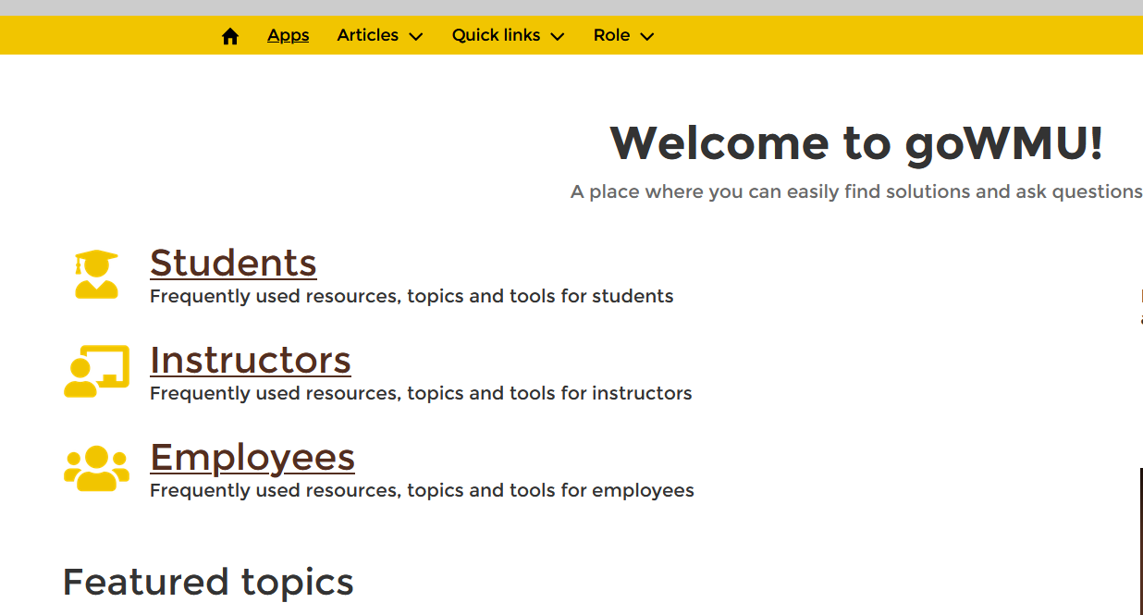
goWMU

Slide 20
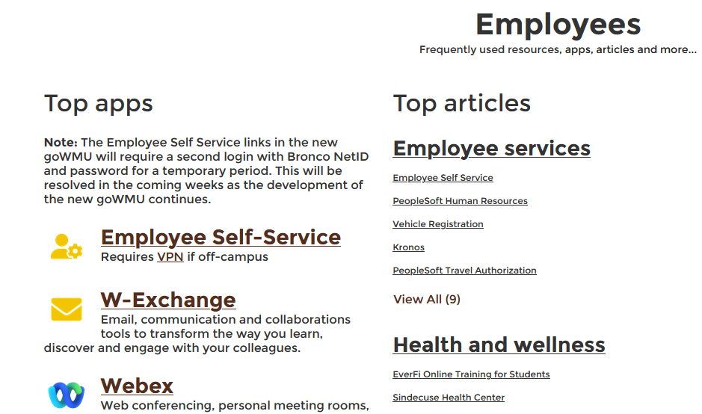
goWMU

Slide 21
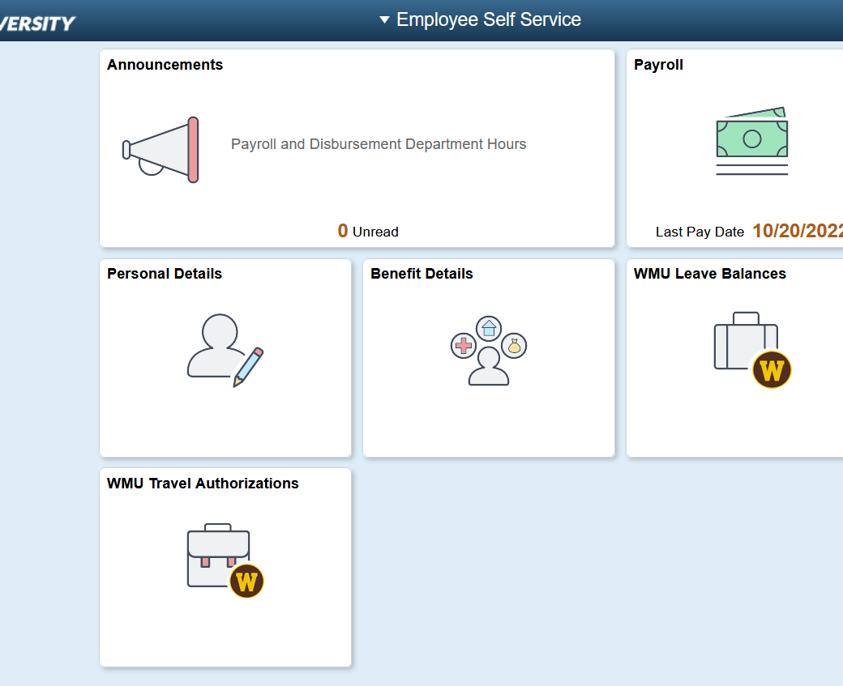
Accessing Form I-9

Slide 22
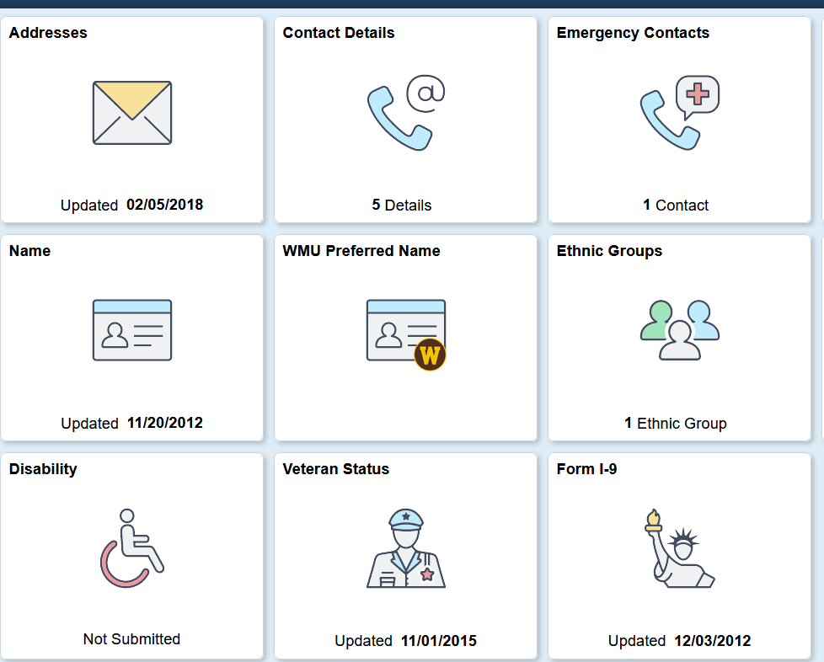
Accessing Form I-9

Slide 23
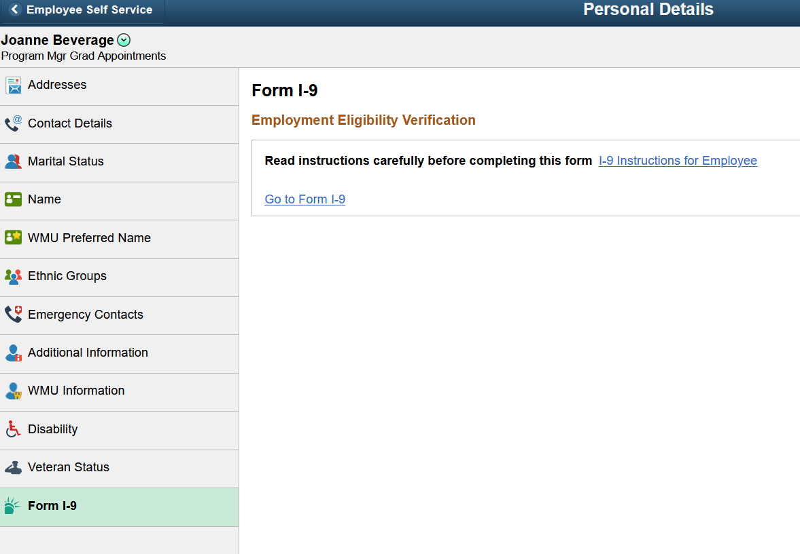
Completing Form, I-9

Slide 24
Direct Deposit

Slide 25
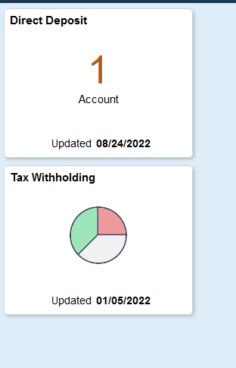
Direct Deposit

Slide 26
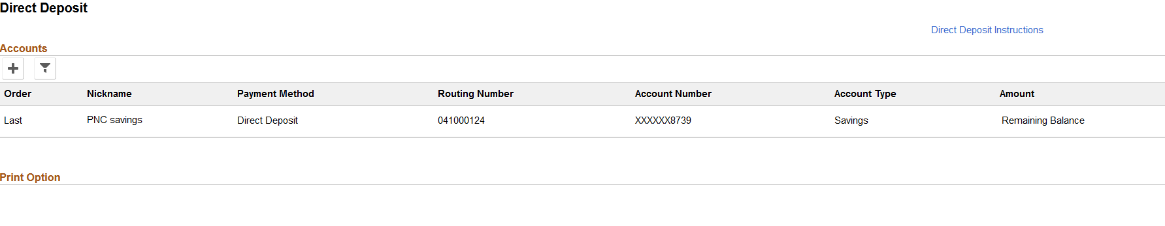
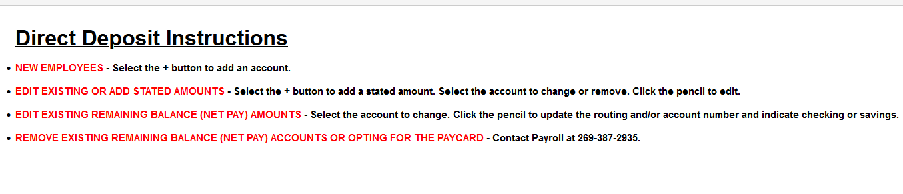

Slide 27
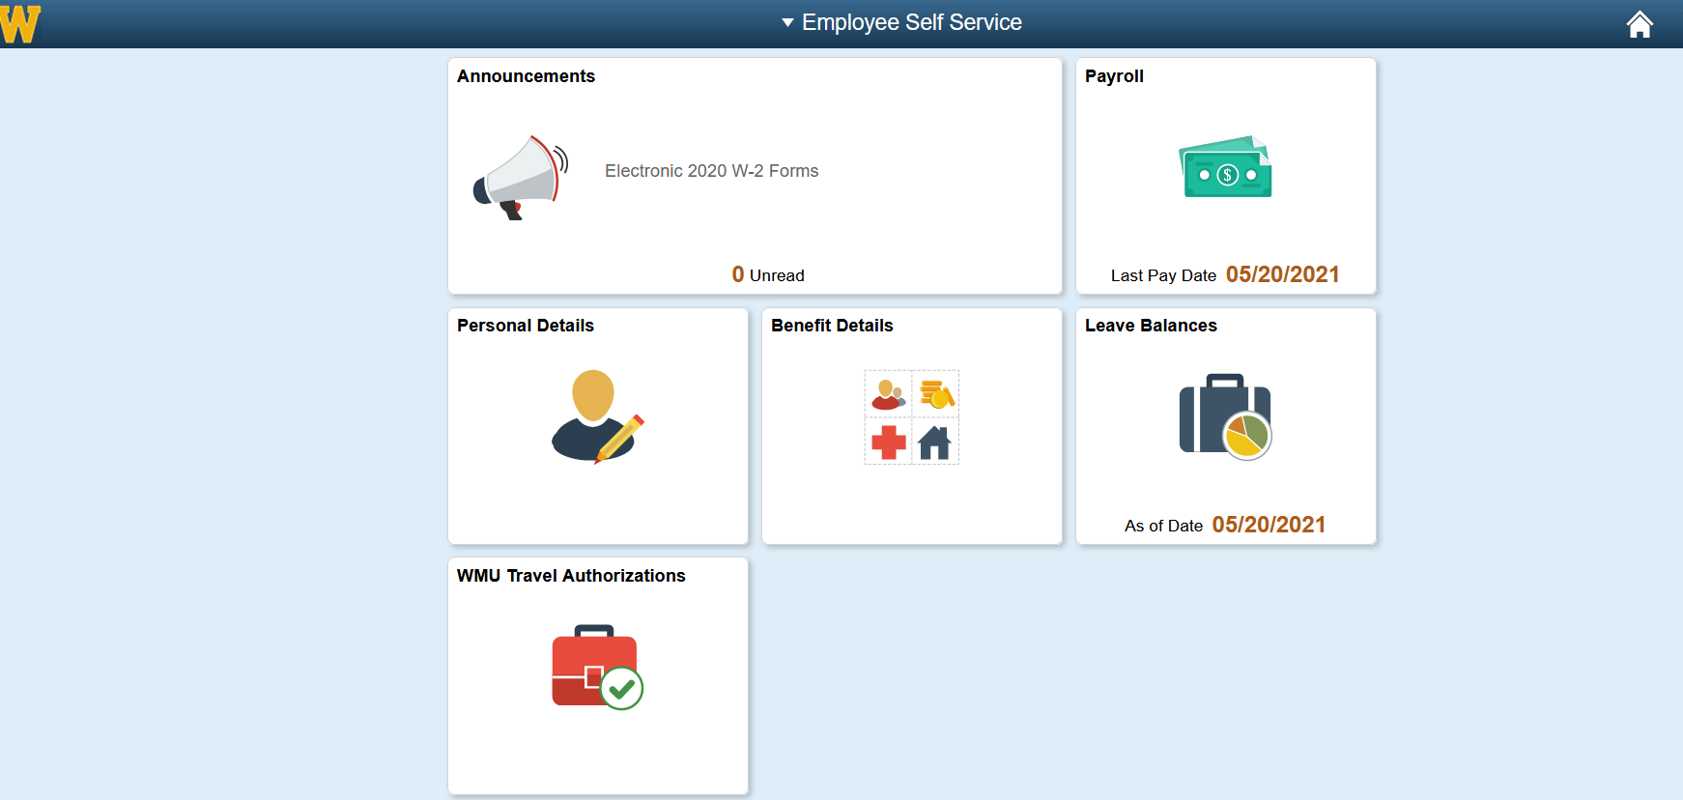
View Paycheck

Slide 28
Enrollment
All Graduate Assistants must be registered for credits in the semester or session they hold an assistantship.
Students must register themselves in courses, please consult with your academic advisor on which courses to register for.
Instructions on how to register are found on the Registrar’s Office website at wmich.edu/registrar/students/registration.

Slide 29
Tuition Remission
Disburses on:
Fall 2025: August 22, 2025
Spring 2026: January 7, 2026
Graduate College forms are available at wmich.edu/grad/forms
Permission to under-enroll (take fewer than 6.0 credits)
Permission to include 3000-4000 courses (master’s only)

Slide 30
Parking Pass
wmich.edu/parking
WMU Parking Services uses a virtual parking permit system.
Obtaining a permit is easy!
To start, click the yellow “Get a Permit” button on the Parking Service website.
A parking permit is required on the first day of class for each semester and allows parking in designated lots.

Slide 31
Parking Pass
wmich.edu/parking
WMU Parking Services uses a virtual parking permit system.
Parking permits are required on the first day of class for each semester and allows parking in designated lots.
How to request your permit:
  Submit your request on or after August 18, 2025
  Parking Services
  Click the yellow “Get a Permit” button
  Click the "Student" tab
  Your Graduate Assistant classification is automatically uploaded to our parking system so you will be issued the appropriate student permit upon check out.
  Click "Pay" to complete the process (you will not be charged). The confirmation page will reflect the payment method as "Bill to OBF web."

Slide 32
WMU Bronco Card
wmudps.wmich.edu/bronco-card.php
The WMU Bronco Card® is your photo identification card at Western Michigan University, as well as used:
As your Library Card
For dining services access and Dining Dollars
For access to the Student Recreation Center
At the Computer Centers
As a security access card to many on-campus buildings
For sport event entry (select events/students only)
To ride the Metro bus for free around campus and throughout the Kalamazoo area by showing your Bronco ID to the driver when boarding.

Slide 33
WMU Bronco Card
wmudps.wmich.edu/bronco-card.php
Get your WMU Bronco Card online at wmudps.wmich.edu/bronco-card.php
  Upload a photo
  Within two business days, visit Parking Services to pick up your ID card
Need your ID immediately? Can’t access the website?
  Visit Parking Services during regular business hours
  Cards are typically printed within minutes

Slide 34
Responsible Conduct of Research
wmich.edu/grad/current-students/responsible-research
Ethics course
Required of all new graduate students
Automatically registered
No fee, not for credit
Pass with 70% or higher
Approximately 1-2 hours to complete
Deadline end of 1st semester of program

Slide 35

Graduate Appointee Information
Contact me anytime!
grad-awards@wmich.edu
(269) 387-8247

Slide 36
Resources for Graduate Students
Dr. Malia Roberts, Senior Director of Graduate College Enrollment

Slide 37

COMPASS
Centered on Mentoring, Professionalization, and Student Success, COMPASS will serve as your go-to guide for graduate school study.
How do I get published?
Which awards am I eligible for?
What is an IDP and why do I need it?
How do I ask people to mentor me?
What’s process for responding to a CFP?
How do I give a successful conference presentation?
Do I need a personal academic website?
What can I do to get leadership experience?
COMPASS has the answers to those questions and more! Visit the
Graduate College website and look for the 8-point COMPASS logo.

Slide 38
WMU Student Services
wmich.edu/studentservices
Career & Student Employment Services
Counseling Services
Experience WMU
Graduate College professional development events
Office of Faculty Development
Office of Research & Innovation
University Libraries & Grad Student Commons
WMU Recreation Center
WMU Signature
WMU Writing Center

Slide 39

University Libraries
wmich.edu/library

Slide 40
WMU Graduate College
wmich.edu/grad/assistantships/ga-orientation
Final Steps
Attend position-specific training:
  TAs: Monday, August 25, 9 a.m. to 12 p.m.
  RDs: Monday, August 25, 9 a.m. to 12 p.m.
Review the training booklet for your role as a Teaching, Research, or Service Appointee
Familiarize yourself with important policies:
  Graduate Appointee policies
  WMU FERPA Policy
  WMU Policy on Sexual Misconduct
Submit the Graduate Appointee Training Verification Form
Complete the Responsible Conduct of Research (RCR) Course
Review Graduate Student Online Orientation (optional)

Slide 41

WMU Graduate College

