Slide 1
Study Abroad &
Global Learning

Slide 2
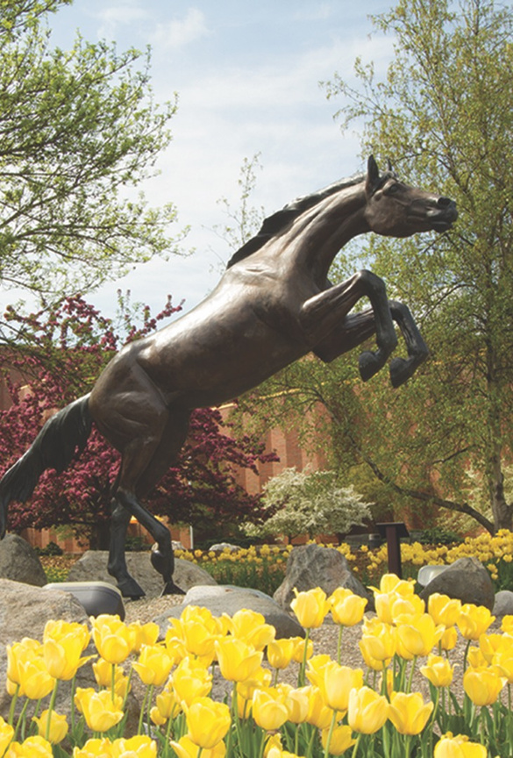
Global Engagement Program (GEP)
Prepare for a globalized world on campus, in the classroom, and abroad!
Earn study abroad scholarships and other awards by:
Attending dozens of free global events throughout the year
Connecting with WMU’s 1,200 International Students at weekly Global Socials
Enrolling in courses with a global component – over 80 to choose from
Studying abroad
Conducting international research
Applying to national programs like Fulbright, Gilman, and Boren
And more!

Slide 3
Global Engagement Program Structure
Students can track their progress any time in ExperienceWMU
Status | Requirements | Scholarship & Rewards
Global Bronco | Attend 6 GEP-related events + Meet 2 Global Bronco Requirements | $500 for studying abroad or GEP core course (repeatable but not stackable)
Global Explorer | Complete 1 core course & 1 GEP-approved course (most double-dip towards graduation) | $1000 for studying abroad (repeatable but not stackable)
Global Citizen | Meet 2 Global Citizen Requirements | Letter of recommendation & paid internship opportunities

Slide 4
Haenicke Institute for Global Education
What is Study Abroad?
Gain major, minor, or essential studies credits while living and learning outside the United States.
Programs vary in length from one week to a full academic year.
Travel with WMU instructors and students or go solo.
Plan as early as possible!
Students can study abroad more than once.
Lots of unique scholarships exist just for studying abroad.

Slide 5
Why Study Abroad?
Grow as an individual
Gain the lifelong benefits of improved self-confidence, critical thinking skills, creativity, and more
Succeed professionally
Impress employers with skills you can't get in a classroom alone.
Excel academically
Graduate on time with a higher GPA than your peers.
What's missing?

Slide 6
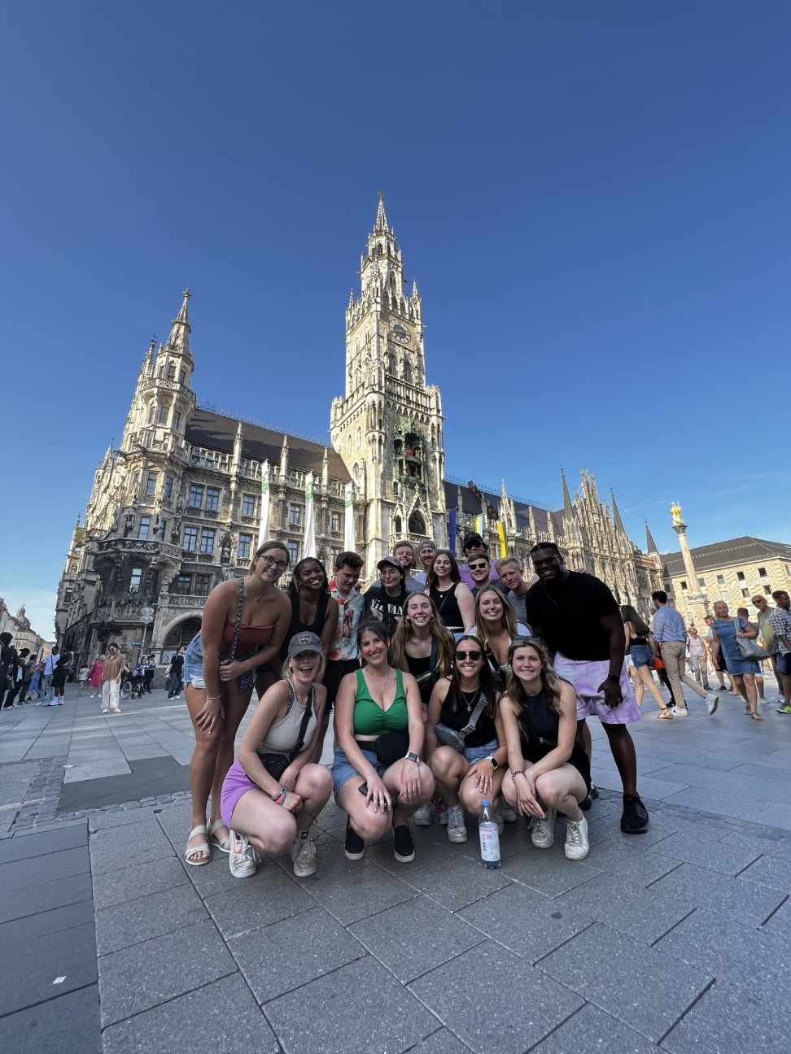
Study Abroad Quick Facts
80+ programs in 30+ countries
Unique Scholarships & Financial Aid available
70% of programs do not require learning another language.
Attend an "Information Session“ to get started!

Slide 7
Affordability & Cost
Program costs vary by:
Number of credits
Type of program
Destination cost of living
Standard financial aid (FAFSA) applies in most cases
Unique Scholarships
Study Abroad Office
Pell Grant
WMU College/Department
National scholarships
Community foundations

Slide 8
Housing & Stay
Where do I stay?
WMU/Host University organizes housing (in many cases)
Housing is almost always included.
Short-term programs:
Hotels, hostels, dorms, rentals
Long-term programs:
Dorms, rentals, homestays (rare)

Slide 9
Program Highlights
Both include automatic scholarships!
Essential Studies Abroad
Take 2 of 8 WES courses taught by WMU instructors in July in Portugal
Open to ALL majors/minors
Business Core Courses in Portugal
Complete 4 foundational business courses in the summer in Portugal
Almost a complete business minor in one summer semester.
Perfect match with other majors!

Slide 10
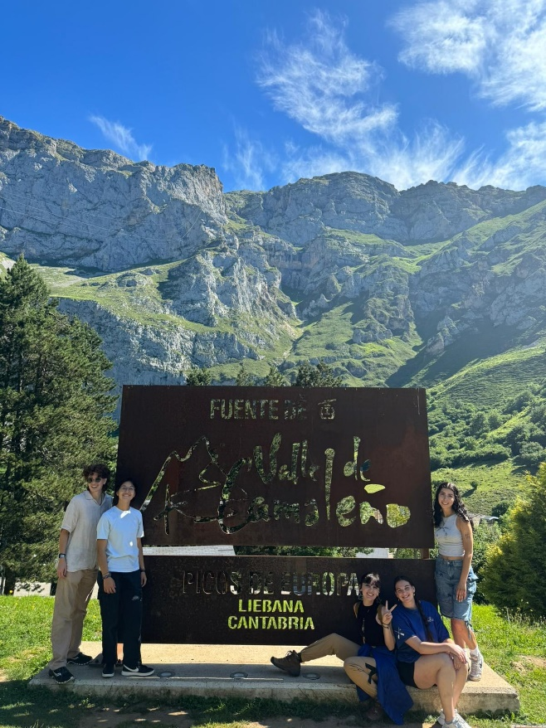
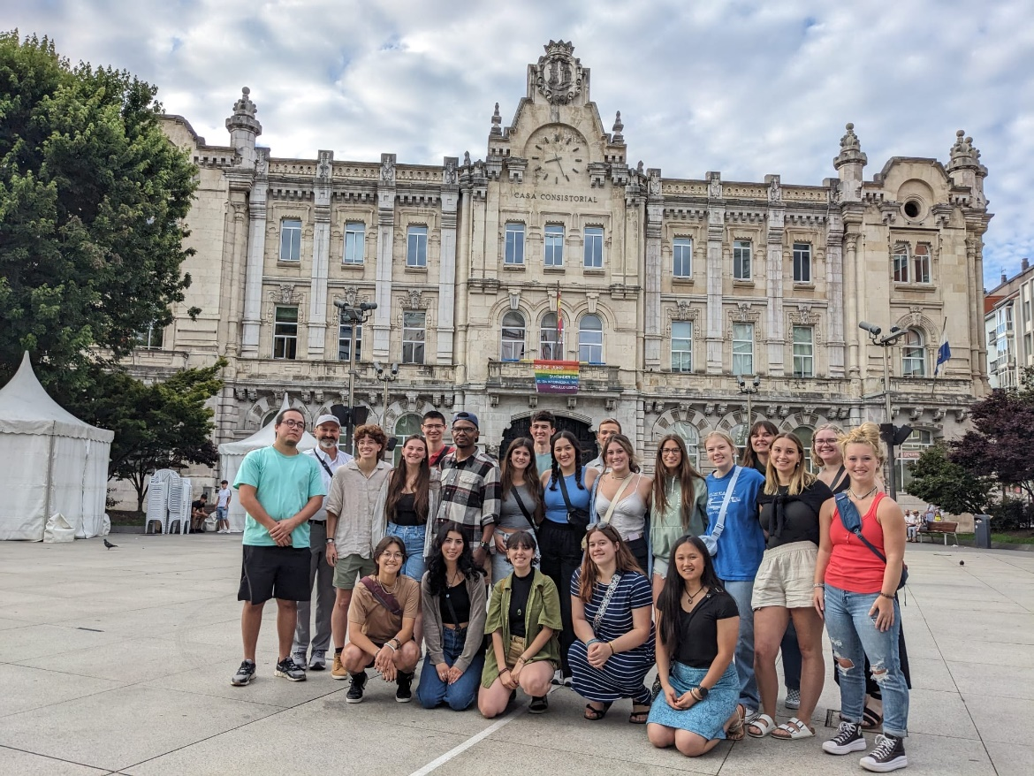
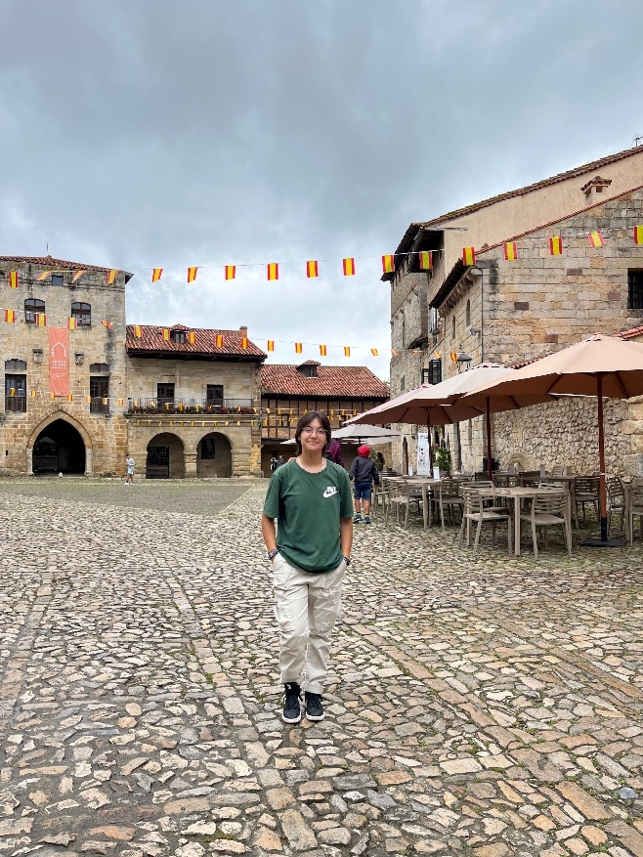
Andreas | Spain
“Am I in pain? No because I'm in Spain! Studying Abroad in Spain has been one of the most amazing experiences of my life. Studying abroad allows you to learn about other cultures through classes while also being able to use that knowledge firsthand and experience what life is really like in a certain country.
If the opportunity presents itself to study abroad, take it, you will not regret it."
- Andreas

Slide 11
Thomas | Dominican Republic
"It was such a humbling and positive experience that has allowed me to build bonds with people from an entire
different country. My favorite part right now is that I am still close with the fellow Broncos who studied abroad with me as well. I’ve built life lasting relationships that I'll cherish forever."
-Thomas

Slide 12
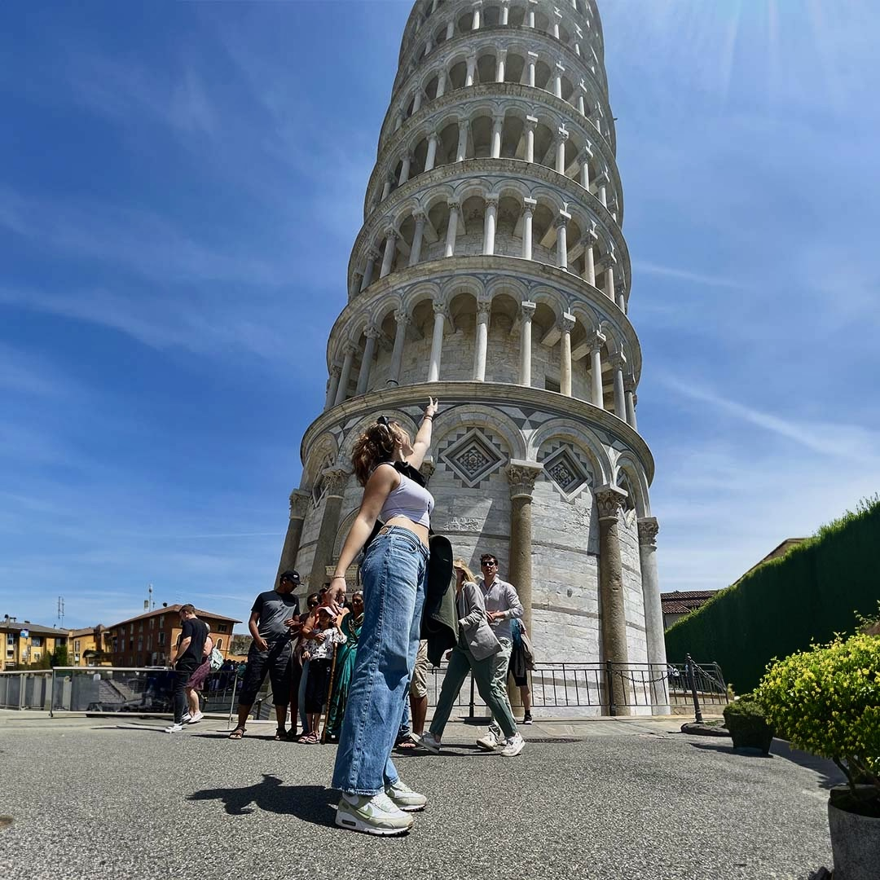
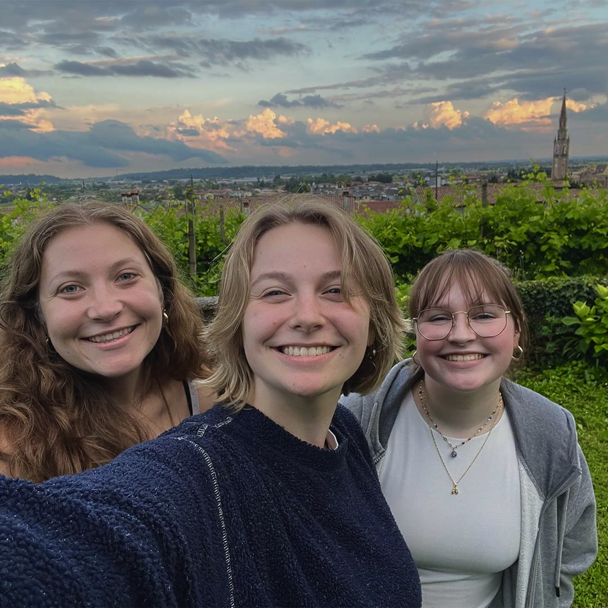
Kelly | Italy
"Studying abroad has always been one of my goals while attending college. I'm so glad that I decided to study book arts in Italy this summer because the trip is far from anything I've experienced before. To be able to not only see iconic art in person, but also gain access to studios with historic equipment is a dream.”
- Kelly

Slide 13
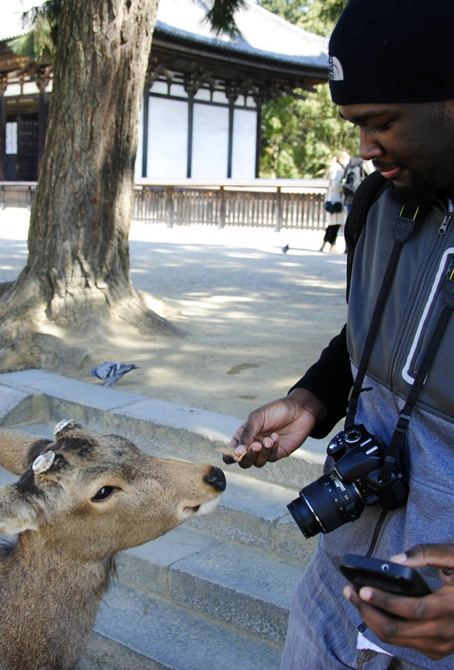
Haenicke Institute for Global Education
Learn more:
Check out programs and scholarships
Follow us on Instagram/Facebook
Learn about the Global Engagement Program
linktr.ee/WMUGlobalEducation

