Slide 1



Pursue a top-ranked program.
Thrive within a diverse & supportive campus.
Prosper in your career.
wmich.edu/apply
Notes:
WMU Brand Color Palette Digital, RGB Sliders
Use photos provided in presentation or replace with your own.

Slide 2


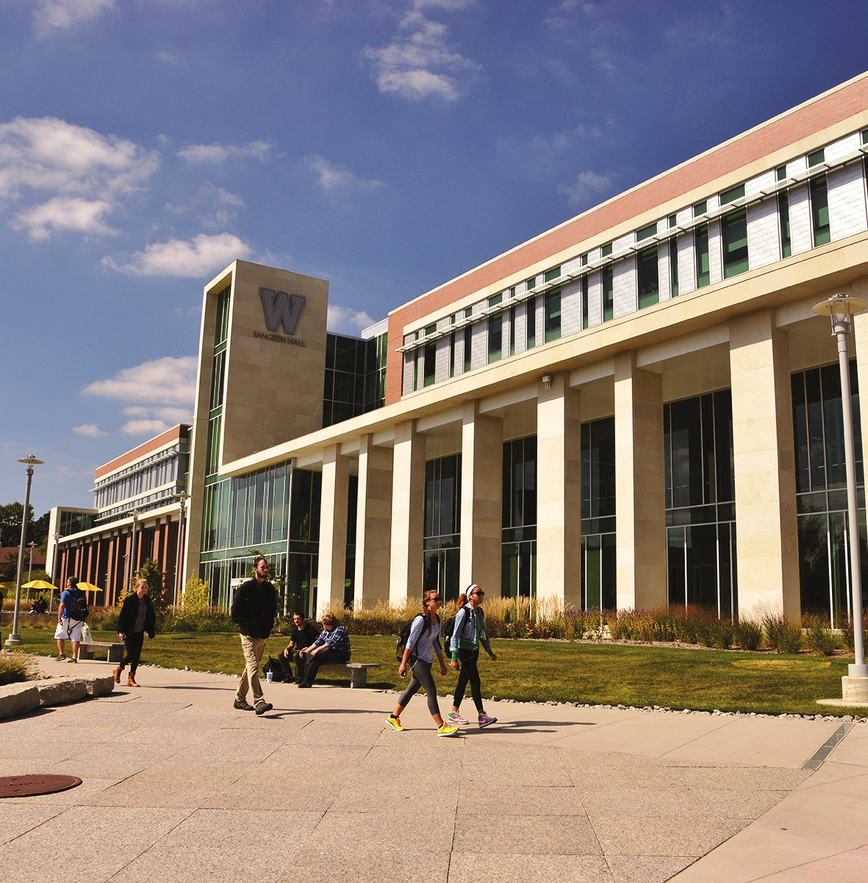

9 of 10
Broncos are employed quickly, working in their field in jobs they like
250
degree programs including bachelor, master and doctoral
Top 20
college town according to WalletHub
Pursue. Thrive. Prosper.
Notes:
Use this photo or replace with your own.

Slide 3


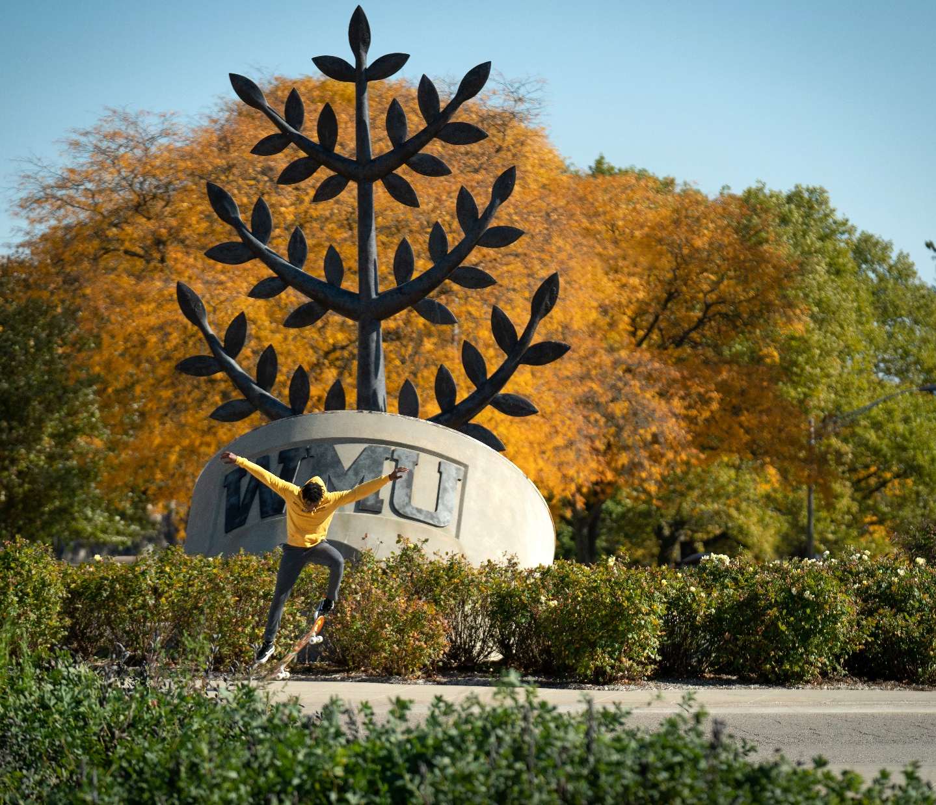

2000+
international students representing more than
90+ countries
6
graduate programs ranked in top 100 in nation by U.S. News & World Report
Extensive
student support including comprehensive immigration services, career services
and tutoring
Pursue. Thrive. Prosper.
Notes:
Use this photo or replace with your own.

Slide 4


250,000+
alumni worldwide in 140+ countries and all U.S. states
94%
of graduates are working or continuing their education
Opportunity
to intern or work
in your field
Pursue. Thrive. Prosper.
Notes:
Use this photo or replace with your own.

Slide 5


Location
Pursue. Thrive. Prosper.
Notes:
Use this photo or replace with your own.

Slide 6
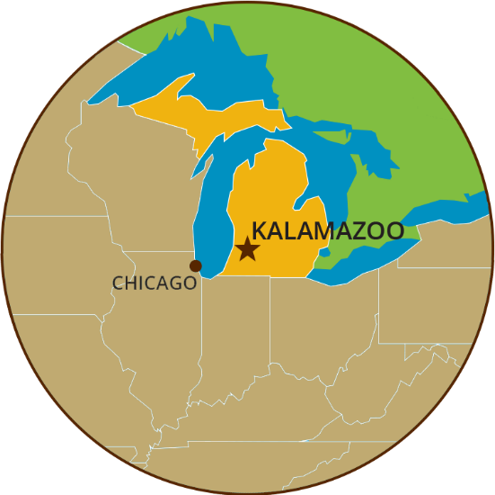
Michigan ranked in top 10 most affordable states by (CNBC).
Kalamazoo ranked in top 20 college destinations in U.S.A. (American Institute for Economic Research).
Two and a half hour train ride to Chicago or Detroit.
Pursue. Thrive. Prosper.
Notes:
Use this photo or replace with your own.

Slide 7



4 of 5
of the Great Lakes are accessible through Michigan
45 min
car ride to Lake Michigan
Largest
fresh water system on Earth and a popular destination
Pursue. Thrive. Prosper.
Notes:
Use this photo or replace with your own.

Slide 8
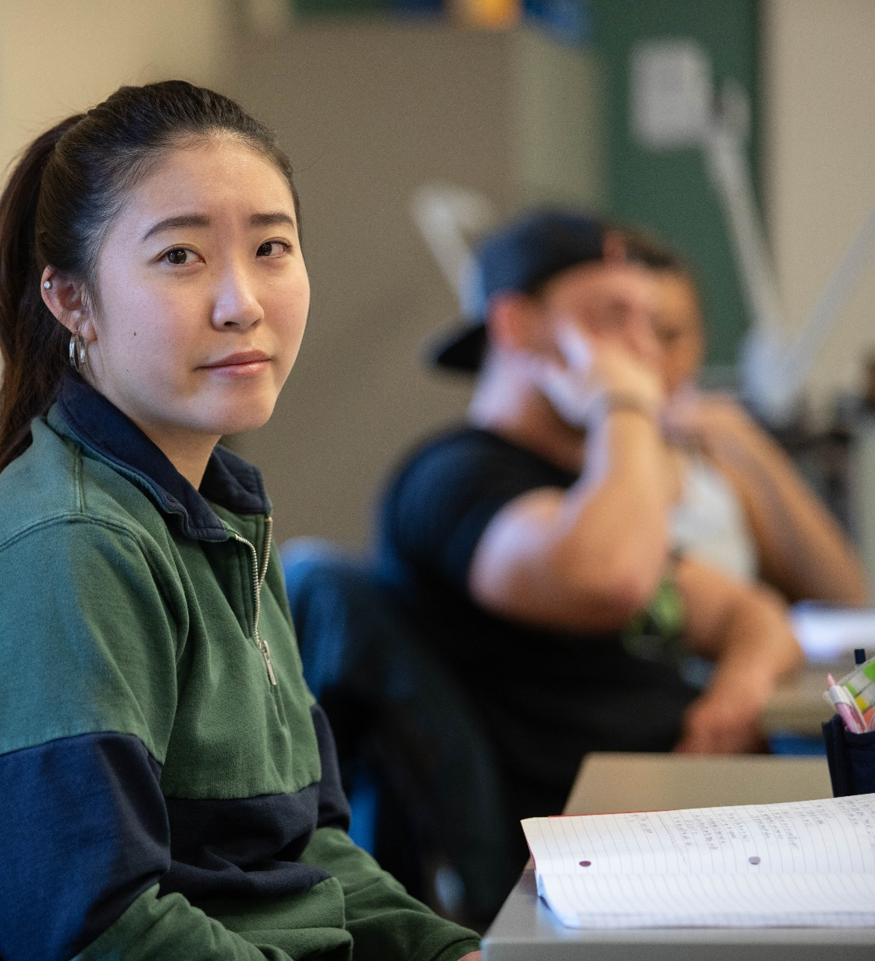
English
Proficiency
Pursue. Thrive. Prosper.
Notes:
Use this photo or replace with your own.

Slide 9
English Proficiency Requirements
Undergraduate
BENEFITS OF
DUAL-ENROLLMENT PATHWAY PROGRAM
​. . . . . . . . . . . . . . . . . . . . . . . . . .
Take academic courses while satisfying English proficiency requirements​​
Earn a bachelor’s degree in less time​
International Student Success seminar that provides assistance in cultural adjustment, an extended orientation to the University and general academic support​
Admission to undergraduate program with a lower proficiency score
 | Regular Academic Admission | Dual-Enrollment Pathway (ESL + Academic Courses) | Full-time ESL
TOEFL | 71 | 52-70 | Not Applicable (N/A)
IELTS | 6.0 | 5.5 | N/A
PTE | 48 | 42-26 | N/A
Duolingo | 100 | 85-95 | N/A
Pursue. Thrive. Prosper.
Notes:
Use this photo or replace with your own.

Slide 10
English Proficiency Requirements
Graduate
Test | Score
TOEFL | 80
IELTS | 6.5
PTE | 54
Duolingo | 115
Completion of the WMU Center for English Language and Culture for International
Students (CELCIS) program!
OR
Some graduate programs may require higher English proficiency scores.
Pursue. Thrive. Prosper.
Notes:
Use this photo or replace with your own.

Slide 11



Center for English Language and Culture for International Students (CELCIS)
Mission
To provide instruction in English as a second language for non-native speakers who will use English to study at an American college or university or in their workplaces.
Established
1975
 | Regular Academic Admission | Dual-Enrollment Pathway (ESL + Academic Courses) | Full-time ESL
TOEFL | 71 | 52-70 | Not Applicable (N/A)
IELTS | 6.0 | 5.5 | N/A
PTE | 48 | 42-26 | N/A
Duolingo | 100 | 85-95 | N/A
Pursue. Thrive. Prosper.
Notes:
Use this photo or replace with your own.

Slide 12

CELCIS Program Options
45
years of teaching English to international students
Study English On-campus
Study English Online
Study English in a Pathway Program
  (Dual Enrollment)
Short English Programs
  (American University Experience)
70%
of CELCIS graduates go on to study at WMU
CELCIS Completion:
No TOEFL or IELTS score is required for restricted admission to most programs at WMU
Pursue. Thrive. Prosper.
Notes:
Use this photo or replace with your own.

Slide 13
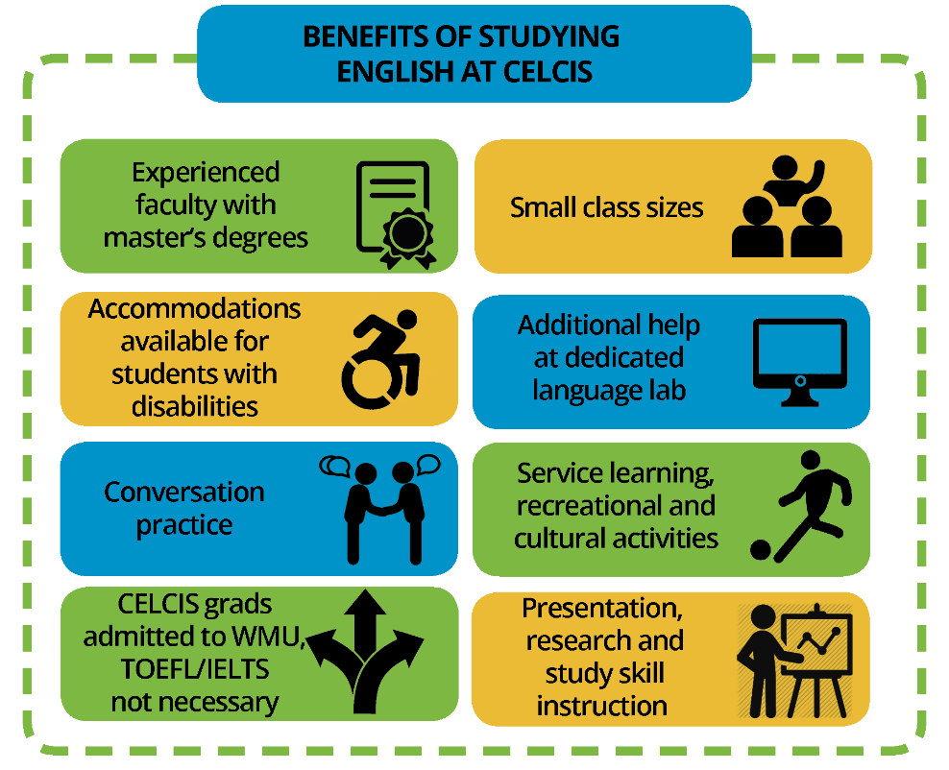
1. Study English on Campus
Curriculum
English language
Academic study skills
U.S. and local culture
Daily Classes
Speaking & Listening
Grammar & Communication
Reading & Writing
CELCIS Calendar
Fall: 15 weeks
Spring: 15 weeks
Summer(s): 7 weeks
Pursue. Thrive. Prosper.
Notes:
Use this photo or replace with your own.

Slide 14
2. Study ESL Online
Study from anywhere in the world
    Courses are delivered over the internet and require no face-to-face meetings.
    Utilize WMU’s Elearning Course Management System
    Online Diagnostic Test
Make progress without delay
Virtual co-curricular activities
Pursue. Thrive. Prosper.
Notes:
Use this photo or replace with your own.

Slide 15
3. Study in a Pathway Program
(Dual enrollment)
Undergraduate and Graduate Pathway options
    Benefits
    Take academic courses while satisfying English proficiency requirements
    Earn a degree in less time
    International Student Success seminar
    Admission to academic program with a lower proficiency score
All undergraduate students with TOEFL scores between 52 and 70 will be encouraged to apply for the Pathway Program.
Pursue. Thrive. Prosper.
Notes:
Use this photo or replace with your own.

Slide 16
Placement Testing:
Oral Interview
Writing Sample
Michigan Placement Test
Center for English Language and Culture for International Students (CELCIS)
Students are given placement tests during orientation
  The Michigan Placement Test includes listening comprehension, vocabulary, reading comprehension and grammar
For each class, students will have a final assessment that CELCIS instructors will evaluate based on a set of rubrics for each level
  Assessments can take the form of oral presentation, research paper
Final Grade =
Class Grade + Assessment Grade
CELCIS Completion:
No TOEFL or IELTS score is required for restricted admission to most programs at WMU
Pursue. Thrive. Prosper.
Notes:
Use this photo or replace with your own.

Slide 17


Center for English Language and Culture for International Students (CELCIS)
Computer Lab
Academic Support
Conversation Circles
Study Tables
Pursue. Thrive. Prosper.
Notes:
Use this photo or replace with your own.

Slide 18

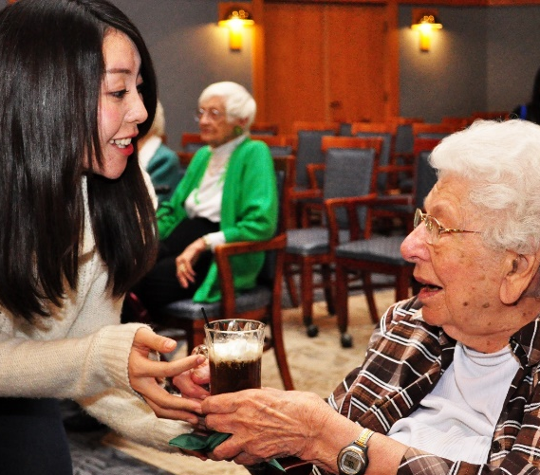
Center for English Language and Culture for International Students (CELCIS)
Recreational Trips
Social and Cultural Support
Cultural
Events
Service
Learning
Pursue. Thrive. Prosper.
Notes:
Use this photo or replace with your own.

Slide 19
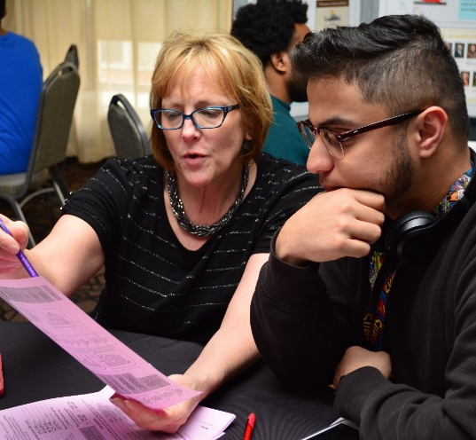
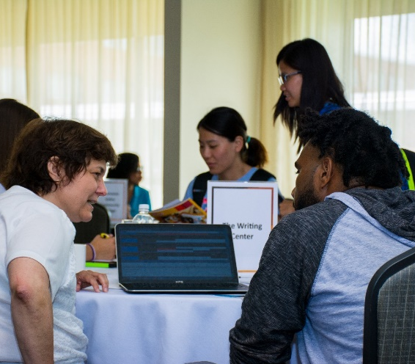
Advising
CELCIS Program
Health insurance
Immigration
Center for English Language and Culture for International Students (CELCIS)
Student Services
Student Advisory
Board
CELCIS Meet
and Greet
Pursue. Thrive. Prosper.
Notes:
Use this photo or replace with your own.

Slide 20
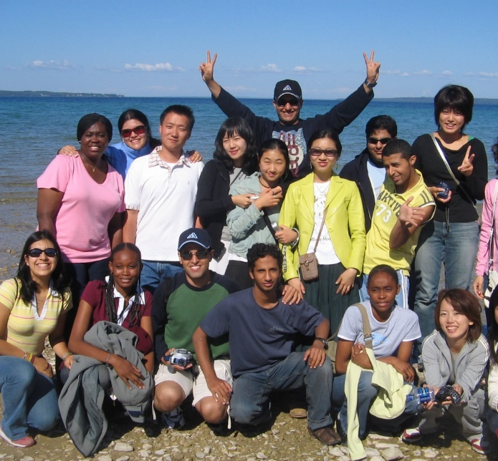
Center for English Language and Culture for International Students (CELCIS)
Benefits
Visit the U.S.
Study at a U.S. university
Experience U.S. culture
Customized program
Short Term Programs
Program Types
Business
Education
Teacher training
Academic writing
Create your own
Customized programs
Groups of 10+ students
4-12 week duration
University students, faculty or business professionals
F-1 or J-1 visas – students on tourist (B) visas are not eligible
Program Options
Housing
Service-learning
Recreational trips
Conversation partners
Pursue. Thrive. Prosper.
Notes:
Use this photo or replace with your own.

Slide 21
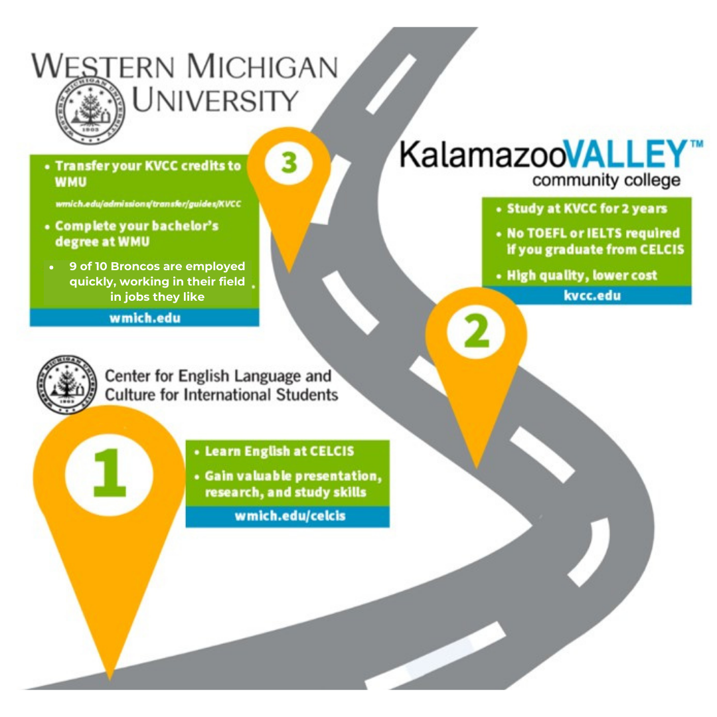
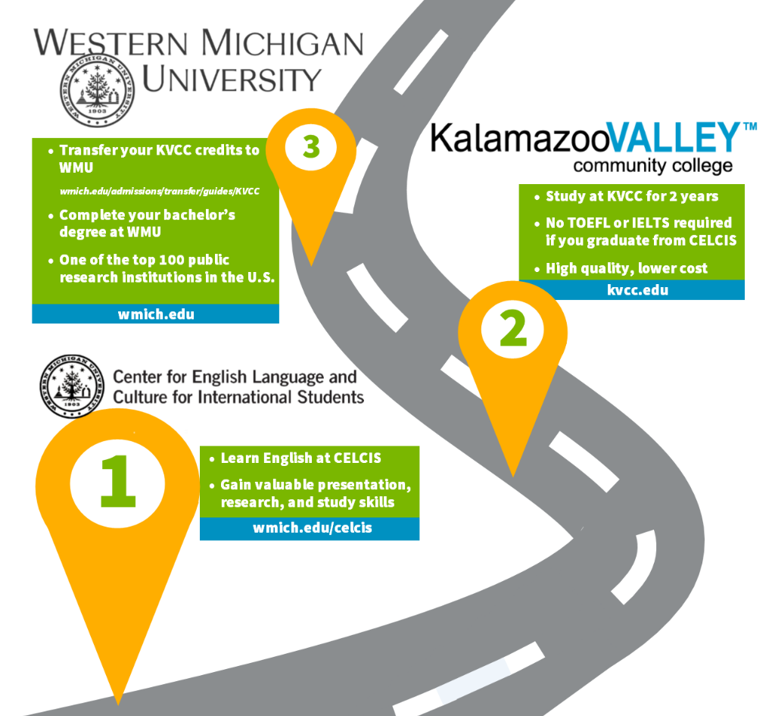
Alternate Roadmap to WMU
1. Learn English at CELCIS
2. Study at KVCC for 2 years
3. Complete bachelor’s degree at WMU
Pursue. Thrive. Prosper.
Notes:
Use this photo or replace with your own.

Slide 22

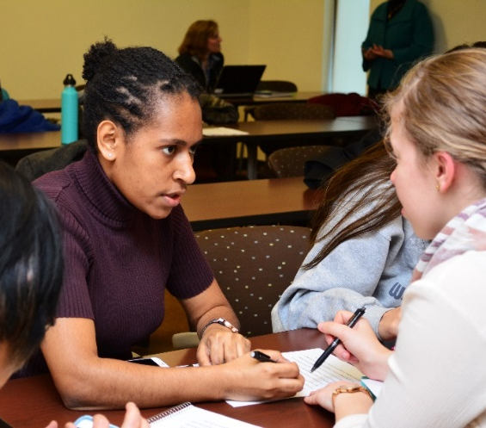
Center for English Language and Culture for International Students (CELCIS)
Academic English courses offered through the College of Arts and Sciences and the Graduate College
Additional Opportunities and Services
MA-TESL and certificate program available
International Graduate Assistant training offered
Pursue. Thrive. Prosper.
Notes:
Use this photo or replace with your own.

Slide 23

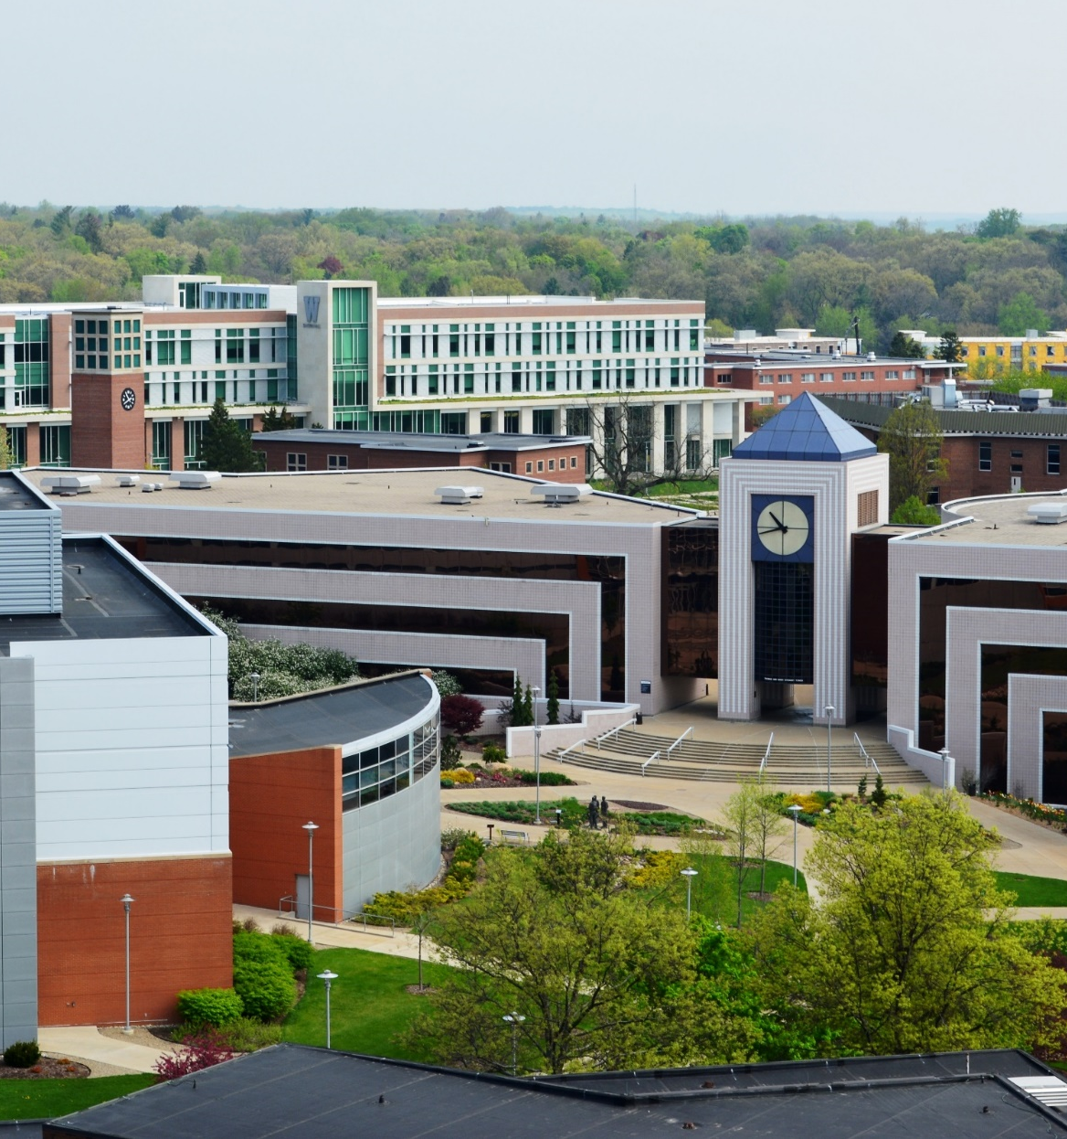
Academics
Pursue. Thrive. Prosper.
Notes:
Use this photo or replace with your own.

Slide 24
60
specialized institutes and centers bolster academic teaching and research
WMU Academic Colleges
Arts and Sciences
Aviation
Education and Human Development
Engineering and Applied Sciences
Fine Arts
Haworth College of Business
Health and Human Services
28
agreements with local community colleges to facilitate transfer to WMU
17:1
student-to-faculty ratio
Pursue. Thrive. Prosper.
Notes:
Use this photo or replace with your own.

Slide 25

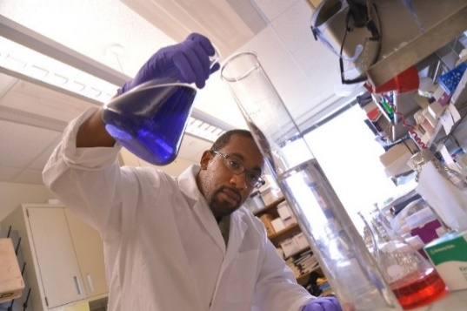
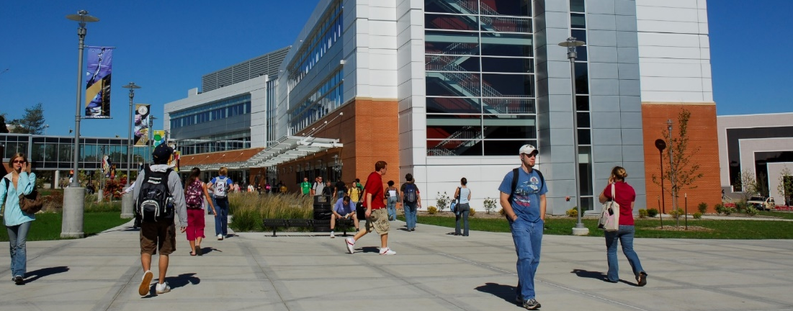
Arts & Sciences
$10M
average dollars in sponsored research every year
26
departments and interdisciplinary programs
6,200+
students enrolled as undergraduates or graduates
Pursue. Thrive. Prosper.
Notes:
Use this photo or replace with your own.

Slide 26
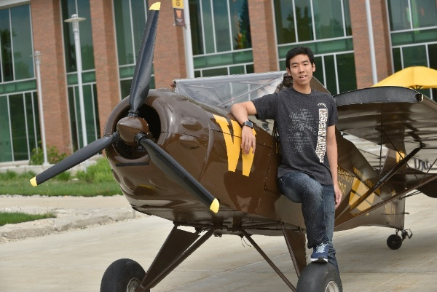

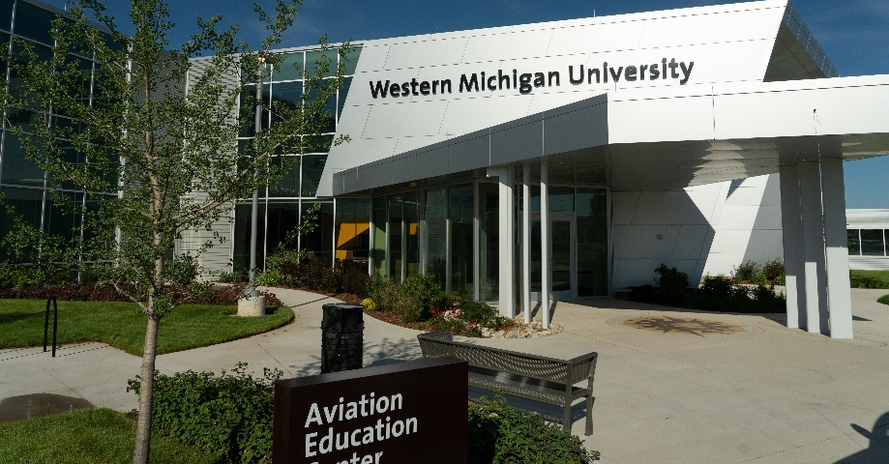
Top 5
ranked aviation program in the nation
Aviation
26
Cirrus SR20s in fleet
Largest
flight school in the Midwest United States
Pursue. Thrive. Prosper.
Notes:
Use this photo or replace with your own.

Slide 27
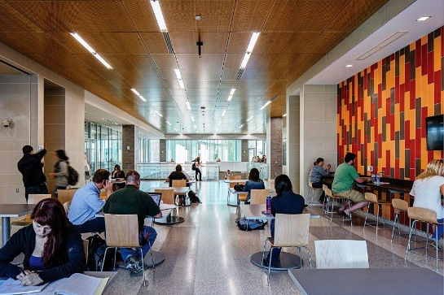


Education & Human Development
100%
of undergraduate students complete and internship or field experience
1st
institute in Michigan to host a TeachLive Lab
#1
producer of master’s
degrees at WMU
Pursue. Thrive. Prosper.
Notes:
Use this photo or replace with your own.

Slide 28
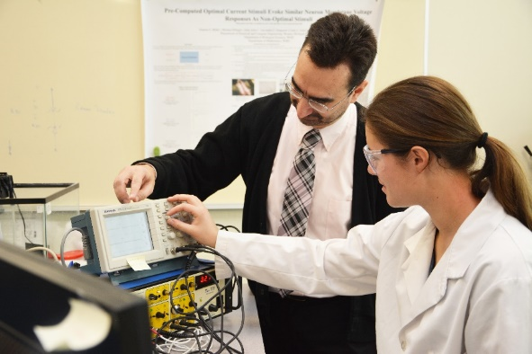
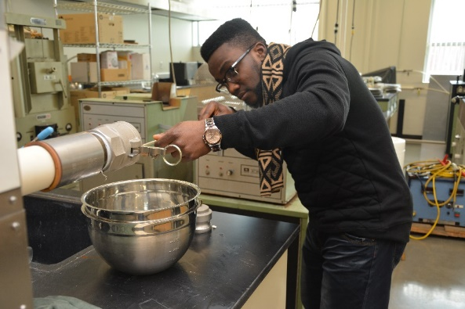
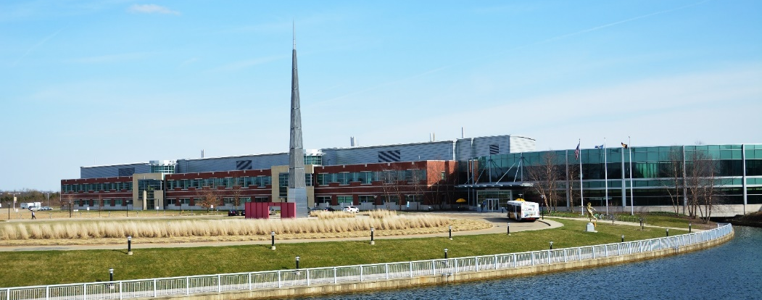
Engineering & Applied Sciences
7
accelerated programs offer both a BS and MS for one additional year of study
75
research and teaching laboratories
323,000
square feet of research and learning space
Pursue. Thrive. Prosper.
Notes:
Use this photo or replace with your own.

Slide 29
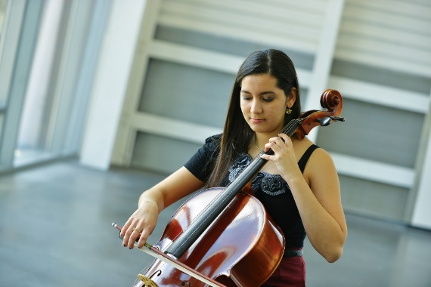

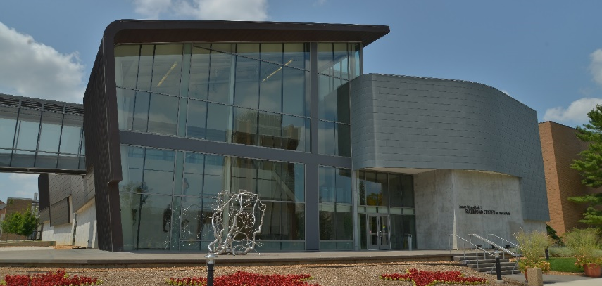
Fine Arts
1000+
performances and exhibitions each year
4
professionally accredited academic programs
150+
Guest artists annually
Pursue. Thrive. Prosper.
Notes:
Use this photo or replace with your own.

Slide 30

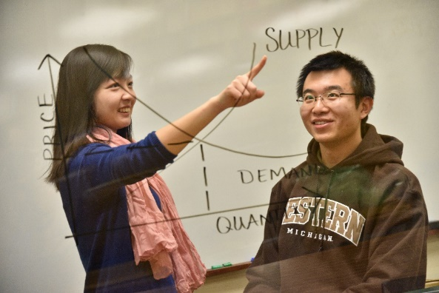
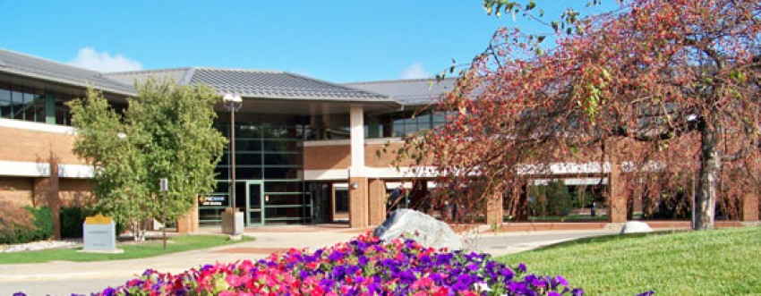
Haworth College
of Business
95%
post graduation
success rate
18
specialized business majors
#1
in nation in sales education and integrated supply chain management
Pursue. Thrive. Prosper.
Notes:
Use this photo or replace with your own.

Slide 31
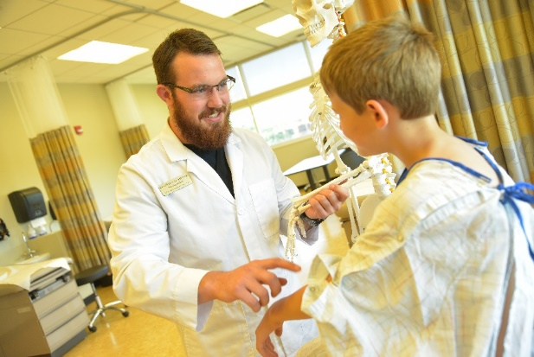
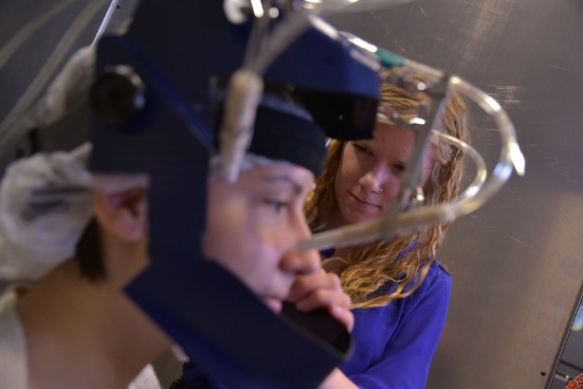
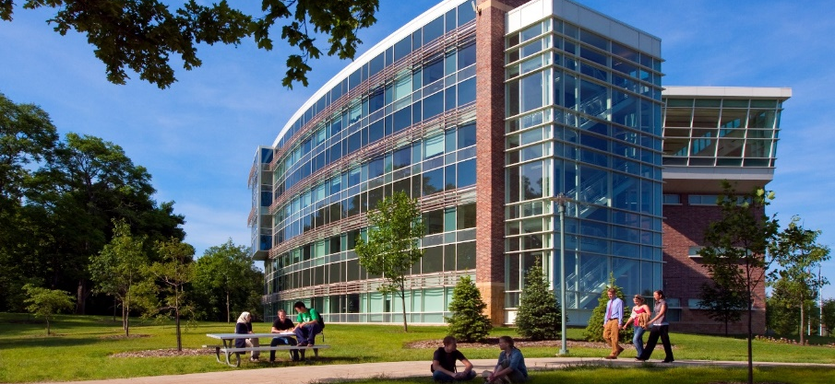
Health & Human Services
4
Programs ranked in top 50 by U.S. News & World Report
$44M
in total research awards
since 2002
15,000
alumni shaping the
future of healthcare
Pursue. Thrive. Prosper.
Notes:
Use this photo or replace with your own.

Slide 32
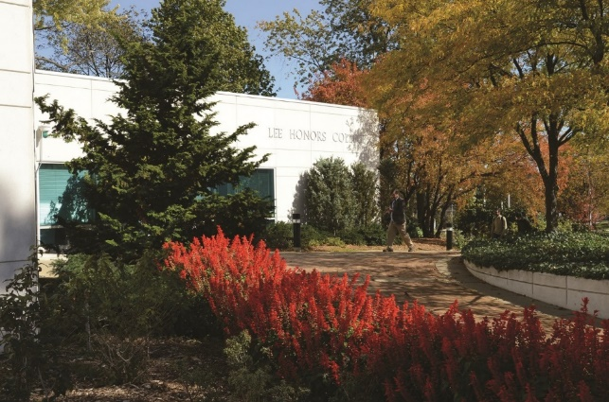

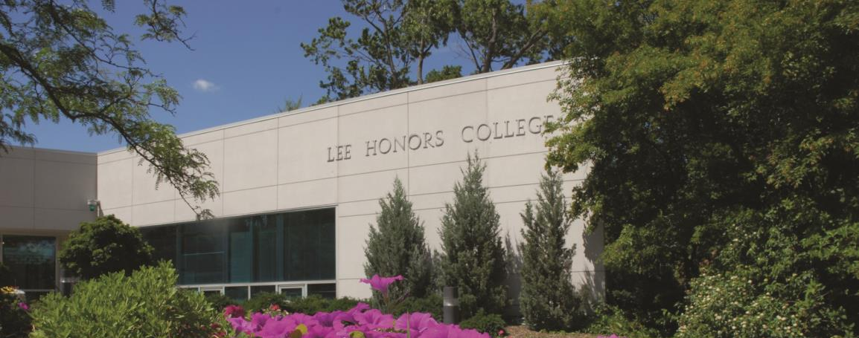
1,700+
students enrolled from all seven academic colleges
Lee Honors College
Scholarships
available to pursue study abroad, research and conference travel
Housing
designated with extended quiet hours for studying
Pursue. Thrive. Prosper.
Notes:
Use this photo or replace with your own.

Slide 33
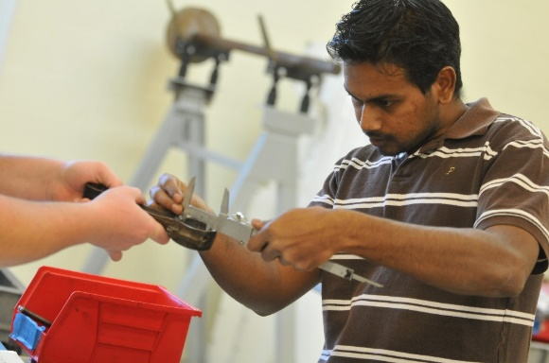
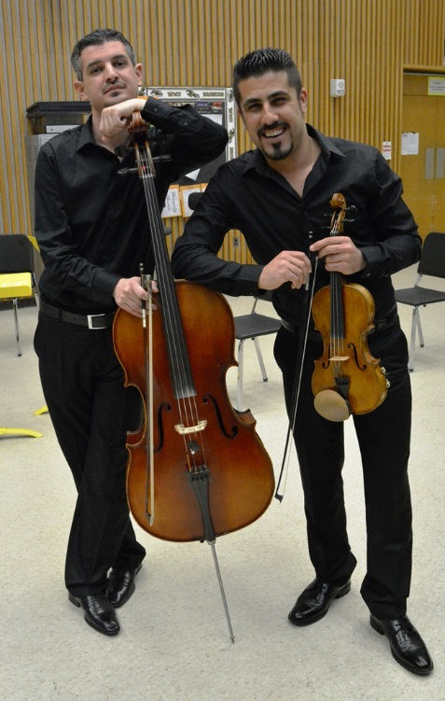

Graduate Studies
120
advanced degree programs across WMU
$180K
awarded to support graduate student research from the Graduate College
15
Graduate programs nationally ranked by U.S. News & World Report
Pursue. Thrive. Prosper.
Notes:
Use this photo or replace with your own.

Slide 34

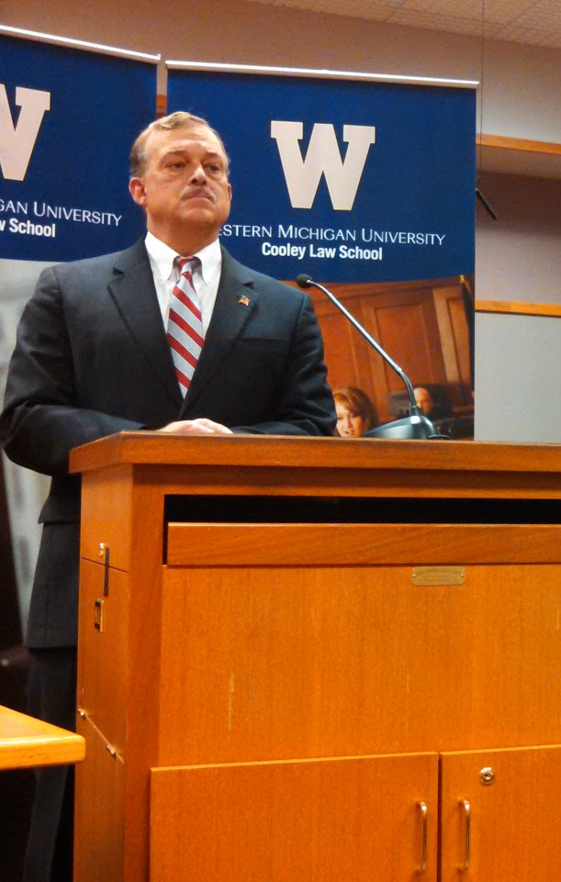

Accredited
by the American Bar Association and the Higher Education Learning Commission
WMU Cooley Law School
Accelerated
degree programs permit WMU students to transfer back credit from law school to complete undergraduate degree
Dual-Degree
Programs offered for JD/MPA, JD/MBA and JD/MSW
Pursue. Thrive. Prosper.
Notes:
Use this photo or replace with your own.

Slide 35
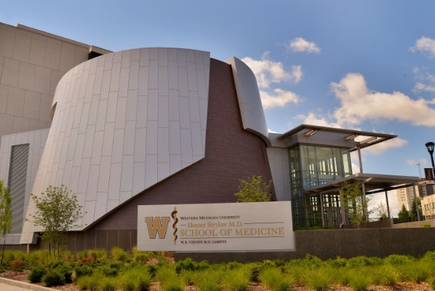
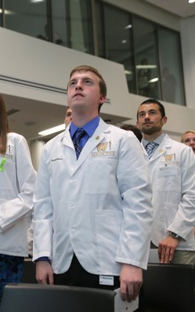
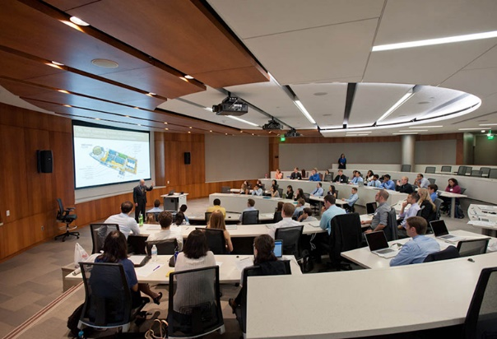
WMU School of Medicine
Accredited
by the Liaison Committee on Medical Education
Collaboration
with Kalamazoo’s two world-class teaching hospitals, Borgess Health and Bronson Healthcare
$69M
building that includes classrooms, labs, study space, fitness center and more
Pursue. Thrive. Prosper.
Notes:
Use this photo or replace with your own.

Slide 36
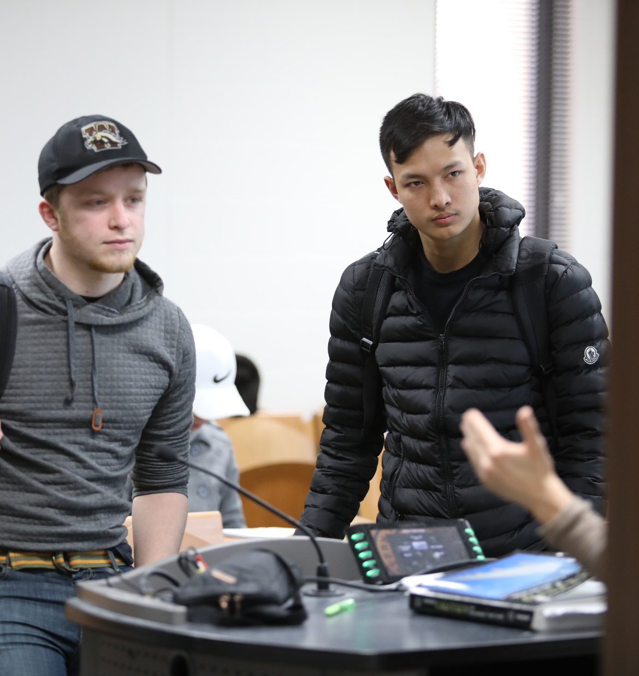
Student Support
Pursue. Thrive. Prosper.
Notes:
Use this photo or replace with your own.

Slide 37
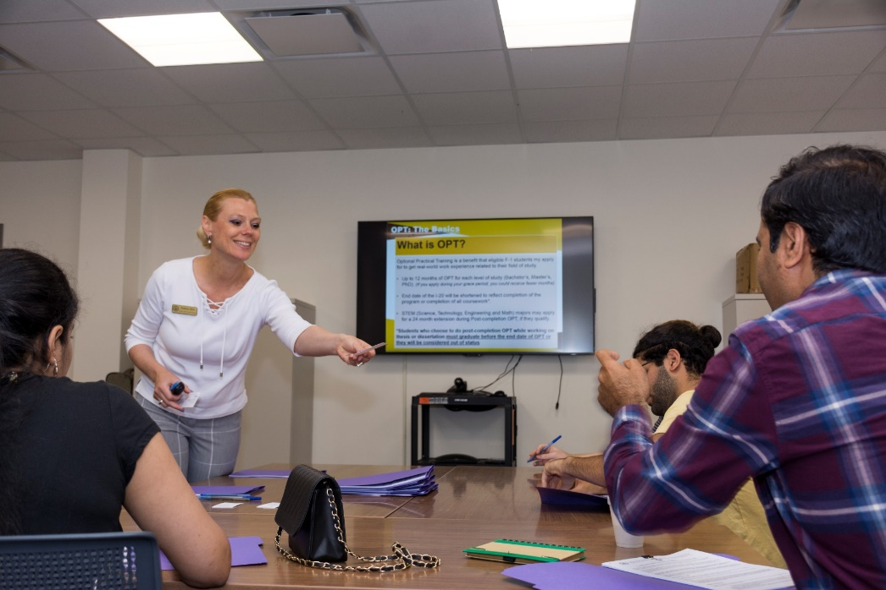
Immigration Services
Helpful
staff of immigration advisors!
Advising Services
Walk-in and virtual advising
Private appointments
OPT workshops
Resources
Immigration forms
Immigration news
Travel signatures
Pursue. Thrive. Prosper.
Notes:
Use this photo or replace with your own.

Slide 38


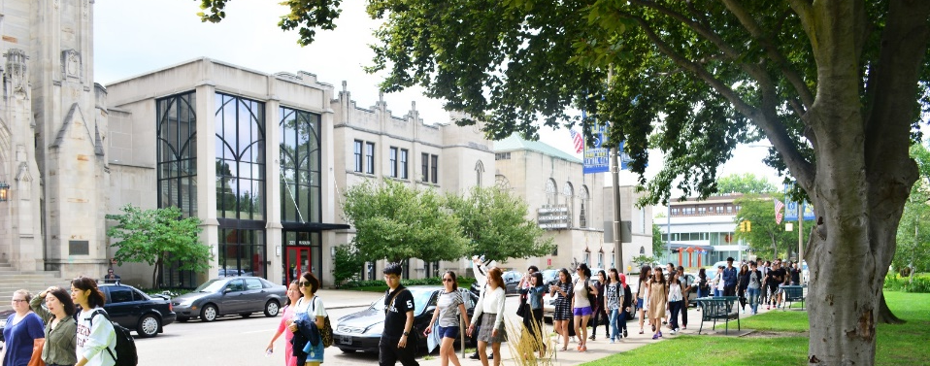
International Orientation
6-week
series of online modules
Connect
with a small cohort of incoming students and a student-leader
WhatsApp
group chats to meet other incoming students and
ask questions
Pursue. Thrive. Prosper.
Notes:
Use this photo or replace with your own.

Slide 39
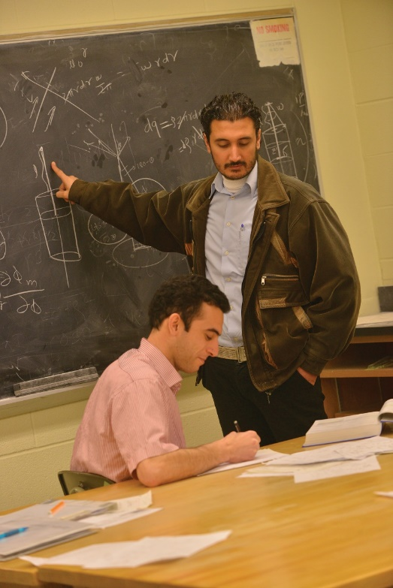


Tutoring & Writing Assistance
Resources & Support
Career Services
College Success Seminars
Pursue. Thrive. Prosper.
Notes:
Use this photo or replace with your own.

Slide 40
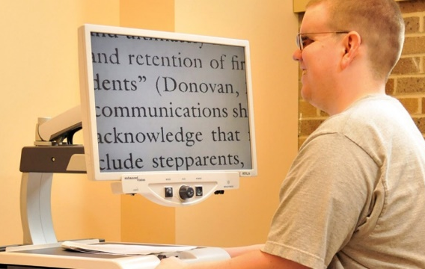


Disability Services for Students
“A person with a disability includes any person who has a physical or mental impairment which substantially limits one or more major life activities.”
Facilities Accommodations
Adaptive computer lab
Classroom furniture
Provision for snow removal
Referral for library search and retrieval
Residential Accommodations
Barrier-free rooms
Single rooms
Restroom facilities
Pursue. Thrive. Prosper.
Notes:
Use this photo or replace with your own.

Slide 41
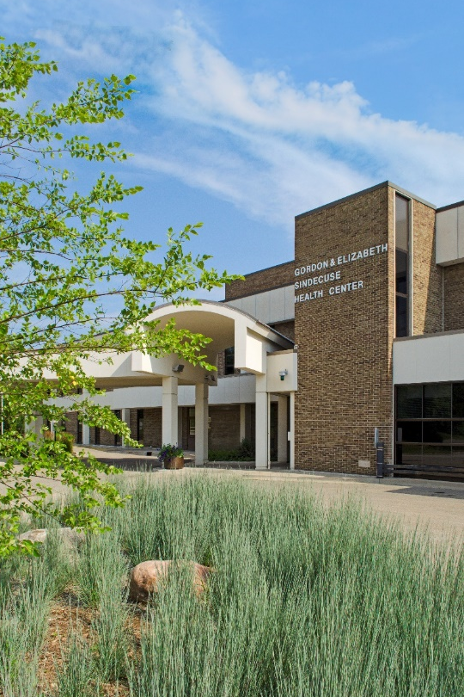
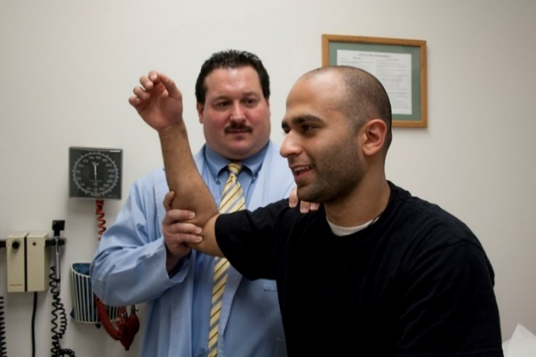
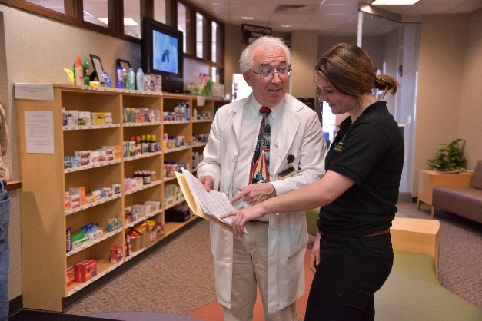
372
combined years of clinical experience serving WMU
Sindecuse Health Center
Easy
to access services and quick scheduling
Located
on the WMU Campus
Pursue. Thrive. Prosper.
Notes:
Use this photo or replace with your own.

Slide 42


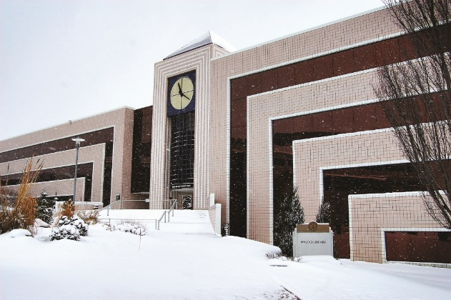
Waldo Library
Top 100
Library systems in the country
4.9M+
Items available for students including books, journals and electronic media
Study
spaces available for
individuals and groups
Pursue. Thrive. Prosper.
Notes:
Use this photo or replace with your own.

Slide 43

Career & Student Employment Services
25,000
jobs posted
Get career advice
Explore career options
Meet employers
Look for jobs
30+
industries covered for
practice interviews
3,000+
internships by major
Pursue. Thrive. Prosper.
Notes:
Use this photo or replace with your own.

Slide 44

Campus Life
Pursue. Thrive. Prosper.
Notes:
Use this photo or replace with your own.

Slide 45

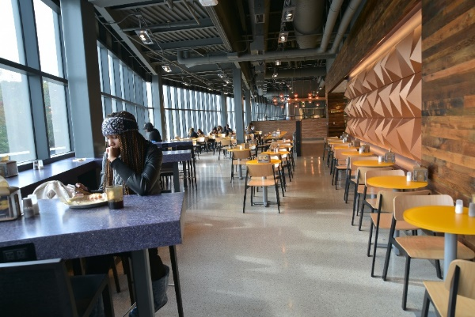
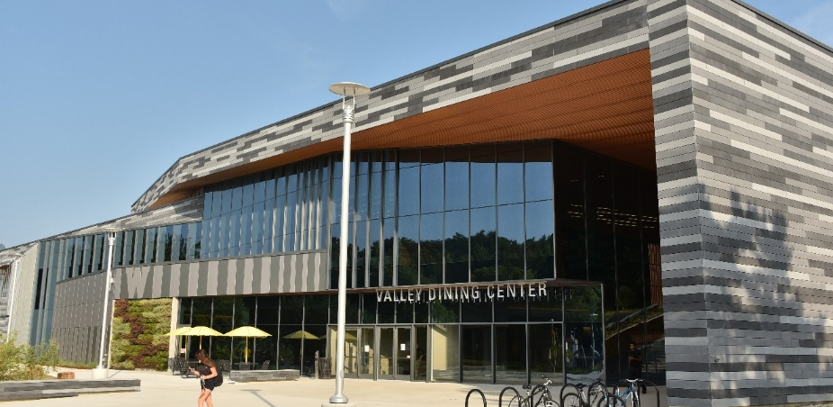
On-Campus Dining
4
dining centers available daily from breakfast through dinner
7
cafes across campus accept cash and dining dollars
Carry-Out
options available
Pursue. Thrive. Prosper.
Notes:
Use this photo or replace with your own.

Slide 46

Residence Halls
1 in 4
students live on campus
20
residence halls
4
apartment complexes
Pursue. Thrive. Prosper.
Notes:
Use this photo or replace with your own.

Slide 47
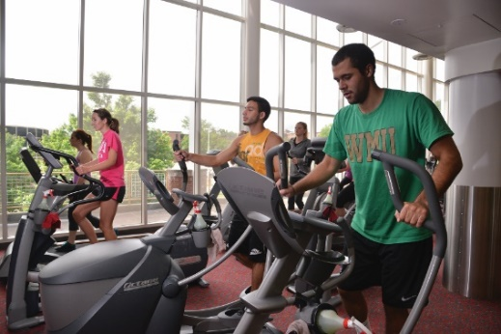

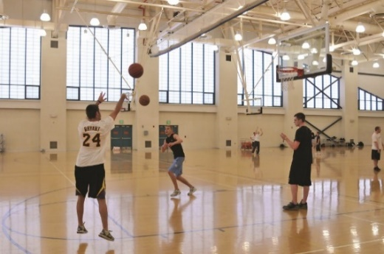
Student Rec Center
35
intramural sports options ranging from football to badminton
$32M
facility that includes aerobic rooms, sports courts, cycling studios and more
376,000+
visits per year
Pursue. Thrive. Prosper.
Notes:
Use this photo or replace with your own.

Slide 48



International Student Population
100+
countries represented
1,000
graduate students
800
undergraduate students
Pursue. Thrive. Prosper.
Notes:
Use this photo or replace with your own.

Slide 49

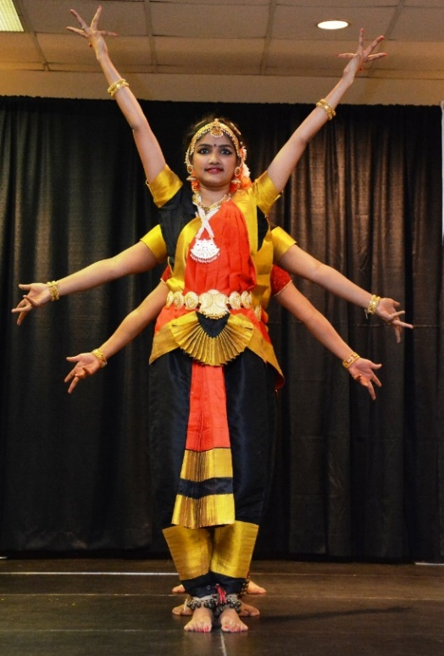

International Student Activities
Parade of Flags
International Festival
International Friendship Program
WMU International Festival
Pursue. Thrive. Prosper.
Notes:
Use this photo or replace with your own.

Slide 50



Extracurricular Activities
Campus Events
Intramural
Sports
Student Organizations
Pursue. Thrive. Prosper.
Notes:
Use this photo or replace with your own.

Slide 51
Financing
Pursue. Thrive. Prosper.
Notes:
Use this photo or replace with your own.

Slide 52
Estimated Costs for 2024-2025
Undergraduate
 | Undergraduate* (lower level)** | Dual Enrollment Pathway Program | ESL (CELCIS)
 | 1 academic year |  | 1 semester
TOEFL/IELTS/PTE/Duolingo | 71/6.0/48/100 | 52-70/5.5/54/85-95 | 51/5.0 or below
Tuition and Fees | $20,533* | $16,097* | $6,075
Living Expenses | $16,547 | $16,547 | $7,930
Total | $37,080 | $32,644 | $14,005
*Tuition varies based on program of study.
**Undergraduate lower level = 0-55 credit hours. Undergraduate upper level = 56+ credits.
Pursue. Thrive. Prosper.
Notes:
Use this photo or replace with your own.

Slide 53
Global Education Merit Scholarship (GEM)
WMU among only 50% of public universities to offer a scholarship designed for international students!
MERIT AWARD FOR:
First-time international students
$10,000 TOTAL
$5,000 Disbursements in Fall & Spring semesters
RENEWABLE
Renewable up to 8 semesters for undergraduate students and 4 semesters for graduate students
Pursue. Thrive. Prosper.
Notes:
Use this photo or replace with your own.

Slide 54
Estimated Costs for 2024-2025
Graduate
 | Graduate (12 credits/year) | ESL (CELCIS)
 | 1 academic year | 1 semester
TOEFL/IELTS/PTE/Duolingo | 80/6.5/54/115 | 51/5.0 or below
Tuition and Fees | $16,815 | $6,075
Living Expenses | $16,805 | $7,930
Total | $33,620 | $14,005
Pursue. Thrive. Prosper.
Notes:
Use this photo or replace with your own.

Slide 55



Graduate Assistantships
Assistantships* in:
Teaching
Research
*Granted by each department
Grad Assistant Training:
Orientation to classroom communication
Training in compensating for non-native American English pronunciation
Opportunities to practice classroom presentation
Feedback from peers and experienced university instructors
Pursue. Thrive. Prosper.
Notes:
Use this photo or replace with your own.

Slide 56

Short-Term Programs
Pursue. Thrive. Prosper.
Notes:
Use this photo or replace with your own.

Slide 57

American University Experience
1-2 Semesters
Study for 1-2 consecutive semesters.
Take academic courses from 140+ undergraduate programs.
On-campus housing with U.S. American WMU Students
Pursue. Thrive. Prosper.
Notes:
Use this photo or replace with your own.

Slide 58



American University Experience
2-8 Weeks
Explore U.S. American language and culture at WMU
Recreational and social activities on campus and in the community
Choose from our list of programs or create your own (for groups of 10 or more).
Pursue. Thrive. Prosper.
Notes:
Use this photo or replace with your own.

Slide 59



Graduate Research “Sandwich” Program
Research at Western Michigan University during the graduate research gap year: the “sandwich year.”
Pursue. Thrive. Prosper.
Notes:
Use this photo or replace with your own.

Slide 60

APPLY
TODAY!
Pursue. Thrive. Prosper.
Notes:
Use this photo or replace with your own.

Slide 61
Applying is easy!
FALL SEMESTER
16 weeks
September – December
Complete WMU’s online application at
wmich.edu/apply
Pay $100 application fee
Submit the following documents
  Official and complete high school/post secondary education transcripts, diplomas, examination results, mark sheets, and certifications (translated to English)
  Proof of degree (translated to English)
  Bank statement or scholarship letter
  Copy of your passport identification page
  Official proof of English language proficiency. Request testing agency submit official scores to WMU directly.
SPRING
SEMESTER
16 weeks
January – April
SUMMER SEMESTERS
7 ½ weeks (two sessions)
May – August
Graduate students should consult with their departments for additional application materials and processes!
Pursue. Thrive. Prosper.
Notes:
Use this photo or replace with your own.

Slide 62

“I am proud to reaffirm our longstanding commitment to diversity and inclusion, to our fundamental belief in the dignity and worth of all human beings no matter their race, ethnicity, gender, national origin, religion, or sexual orientation. It is our differences that make us stronger. Efforts to threaten, demean, or degrade one of us is an assault against our whole community and should not go unchallenged by an inclusive and welcoming campus.”
President Edward E. Montgomery
WMU Welcomes Everyone!
Pursue. Thrive. Prosper.
Notes:
Use this photo or replace with your own.

